Slide 1
ScholarWorks and
Open Access Scholarship at
Montana State University

Slide 2
The Essential Problem
High-impact prestige journals are nearly universally locked behind exorbitantly expensive pay walls
Notes:
This creates problems for researchers who wish to access work, the library who pays for access, and the tax payer who both funds the research and then pays for access

Slide 3
ScholarWorks as a Solution
The promise and potential of future scholarship
  Increased access and visibility
  Increased collaboration
  Faster communication
  Long-term archiving
  Increased rates of citation
Notes:
“Internet still reaches wider than trucks full o' paper.”

Slide 4
What does ScholarWorks do?
Increases access to research for all
Increases impact of citations by enabling greater visibility
Notes:
Let’s ask a more direct question

Slide 5

Source: openaccess.net
Notes:
Intro to closed access/open access

Slide 6
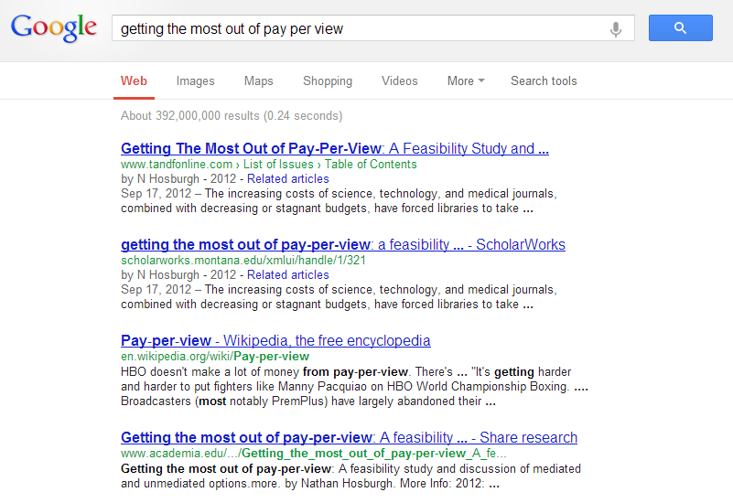
Notes:
Let’s see ScholarWorks in action

Slide 7
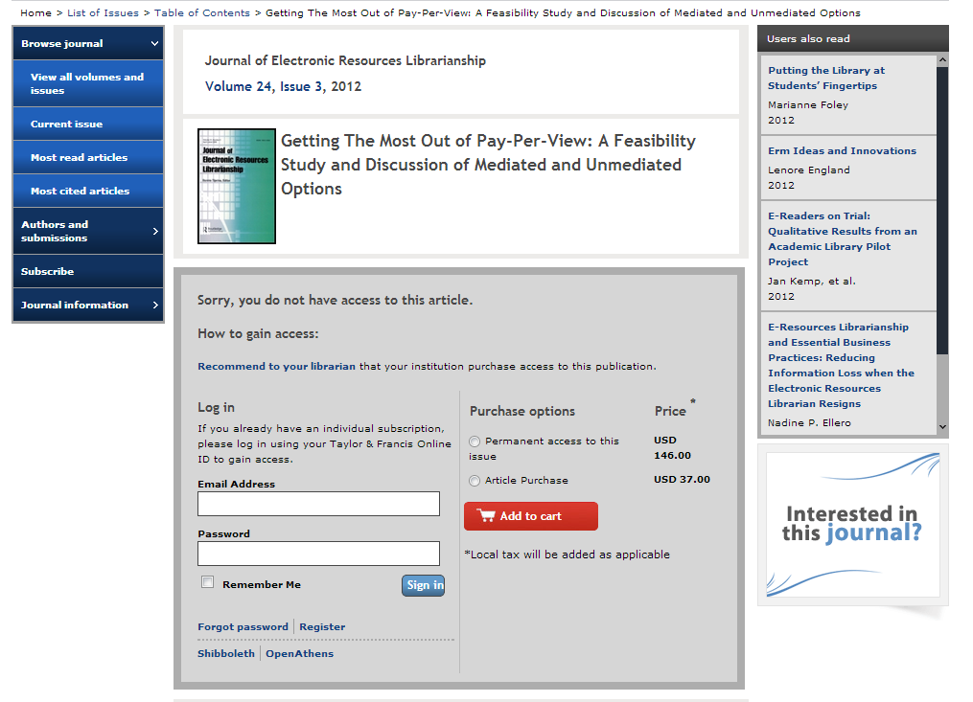
Notes:
Pay wall

Slide 8
Notes:
Let’s see ScholarWorks in action

Slide 9
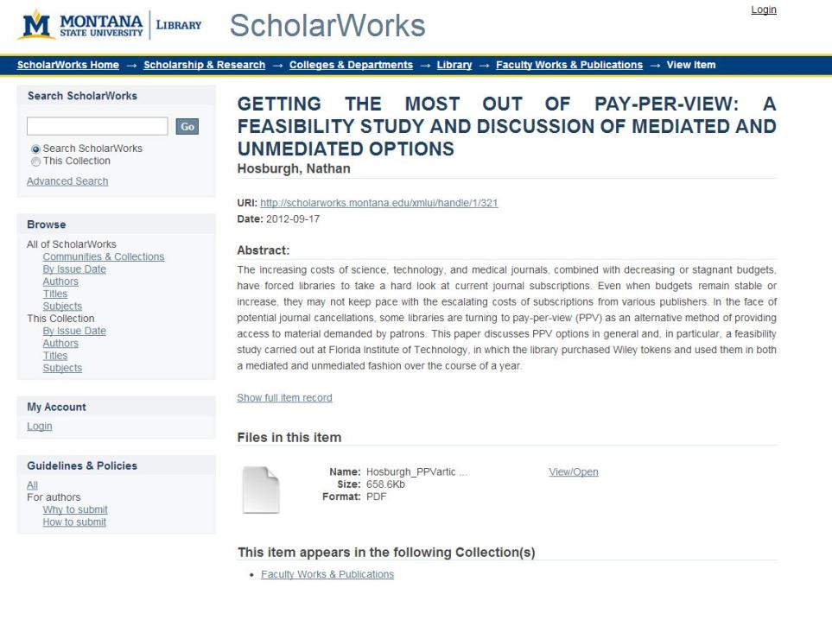
Notes:
No shopping cart, no paywall

Slide 10
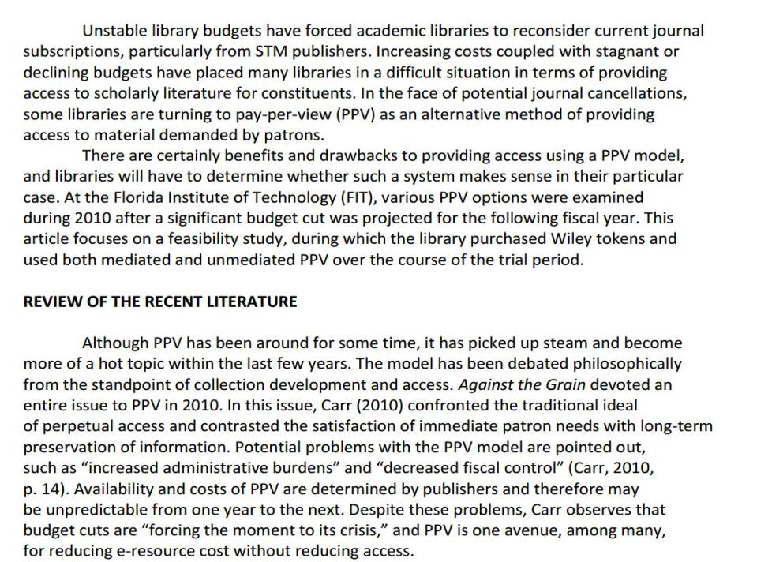
Notes:
How can we stem the tide? This discussion involves library budgets, journal costs, access to research…

Slide 11
ScholarWorks:
A New Way Forward
ScholarWorks is an open access institutional repository
ScholarWorks is a part of the Open Access movement
ScholarWorks is a central point of discovery for scholarship and research
Notes:
IRs common in higher ed: of 108 fellow carnegie class institutions , 96 also have IRs
Open Access publication removes price barriers for potential readers, thus widening the number of researchers that have access to your work.
ScholarWorks provides a platform for publically-funded research to be made available to the public.

Slide 12

Source: openaccess.net
Notes:
Intro to open access

Slide 13

Open Access
Removes price barriers between an author’s work and his or her readers
Addresses the problems of a costly scholarly publishing lifecycle
Sets the foundation for future research and scholarship
Notes:
Now, why do we want a new type of scholarship? Cost and access.

Slide 14
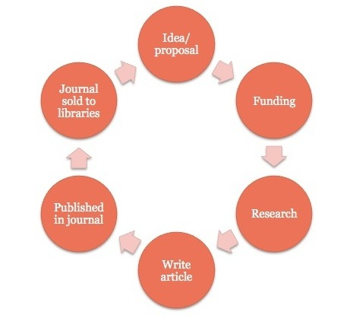
Scholarly Publishing Lifecycle
Notes:
Double-charge model: the public pays for the research to be conducted, and then later pays exorbitant rates for access to that very same research.

Slide 15
Disruptions to the Publishing Lifecycle
Over the last several decades,
the costs of scholarly journals have
skyrocketed.
Source: http://arl.org
Notes:
For the past four decades, the price of scholarly journals has increased at several times the rate of inflation and much faster than library budgets.

Slide 16
Disruptions to the Publishing Lifecycle
Libraries are forced to reduce journal access
Researchers are losing access to scholarly journals
Notes:
Result: significant access problems

Slide 19
Solutions and Opportunities
What value does ScholarWorks offer?
+
+

Slide 20
A Solution for Costs
Tax-payers no longer charged twice for research
Provides sustainable costs for access to research
Notes:
Under the current model, MSU is conducting tax-payer-funded research and then renting back the fruits of that research by purchasing temporary restricted access to these articles from journal and database providers.

Slide 21
A Solution for Access
Research will be made available to the public
Provides platform for NIH/NSF research
Research findable on the open web
Notes:
Access for libraries, access for researchers
Google, google scholar: rich descriptive information
PubMed

Slide 22
A Solution for Control
Copyright is retained by the author
ScholarWorks provides a permanent web address for reliably accessing and citing your work over time

Slide 23
A Solution for Preservation
ScholarWorks commits to responsible and sustainable management of submitted works
Notes:
Part of the library’s core mission

Slide 24
An Opportunity for Students
Provides mentorship opportunities for faculty and students
Allows student alumni to access and share their own research after graduation
Notes:
New possibilities for faculty/student collaborations

Slide 25
An Opportunity for Impact
ScholarWorks allows more people to see our research
Authors who publish Open Access benefit from increased visibility and impact
  Evidence suggests OA publishing can increase visibility and citation rates: http://opcit.eprints.org/oacitation-biblio.html
Notes:
(Key slide for faculty)

Slide 26
Ease of use
“We do it all”: CV-to-ScholarWorks
Library addresses all licensing issues
FAD “hook”
Notes:
ScholarWorks is not a burden on faculty time and resources. As a library-led and university-endorsed initiative, this is an opportunity to share work and increase access and visibility.

Slide 27
Questions you may be asking
Can previously-published articles be submitted to ScholarWorks?
How does the Library know that an article can be submitted to an Open Access repository such as ScholarWorks?
What do submissions look like?

Slide 28
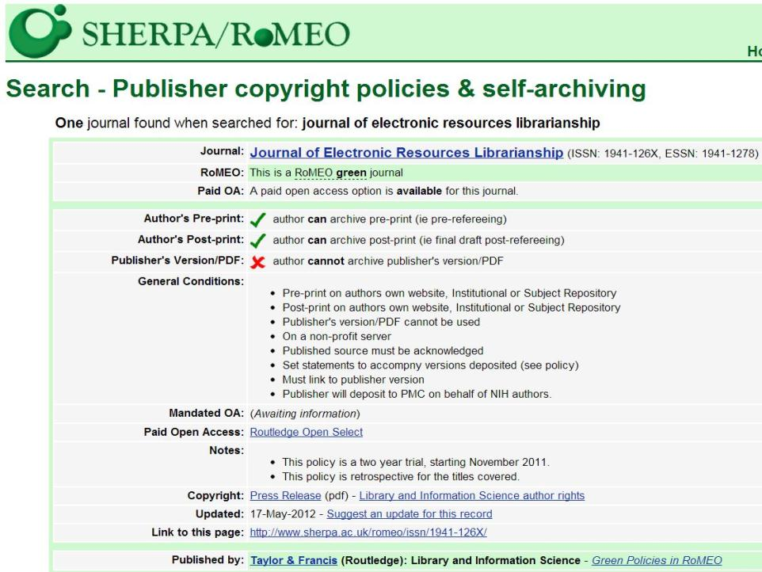

Slide 29
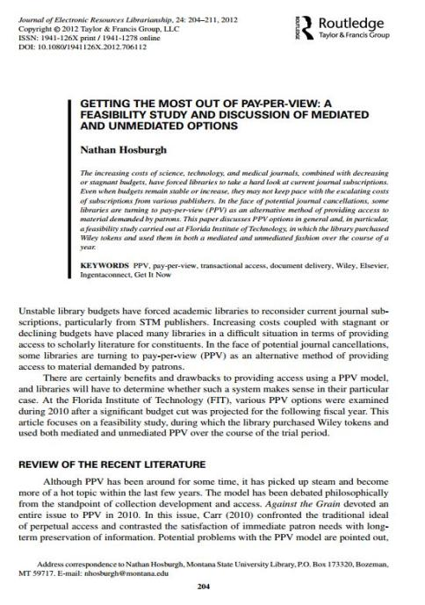
Published
Version

Slide 30
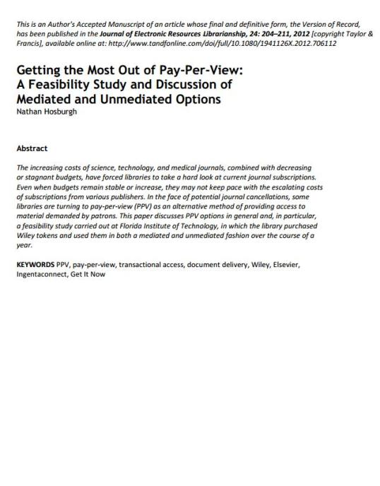
Author’s
Version

Slide 31
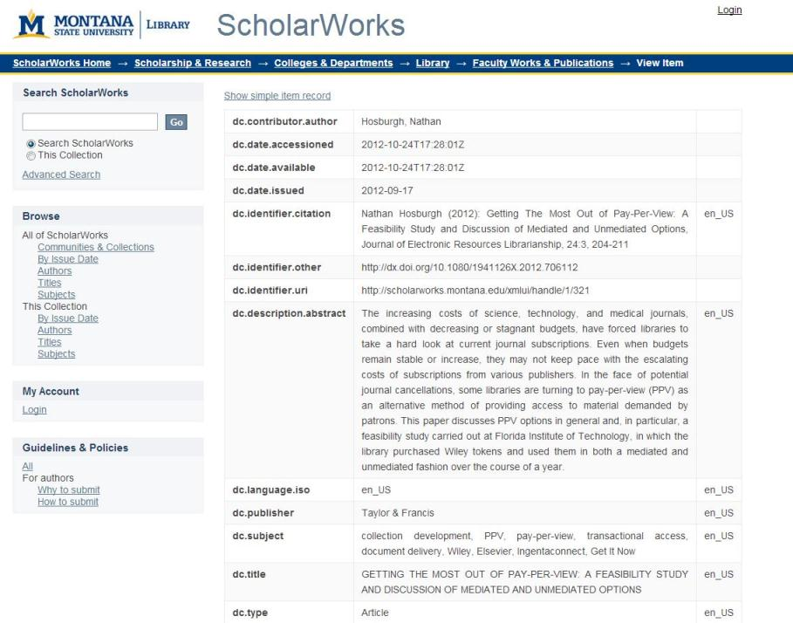

Slide 32
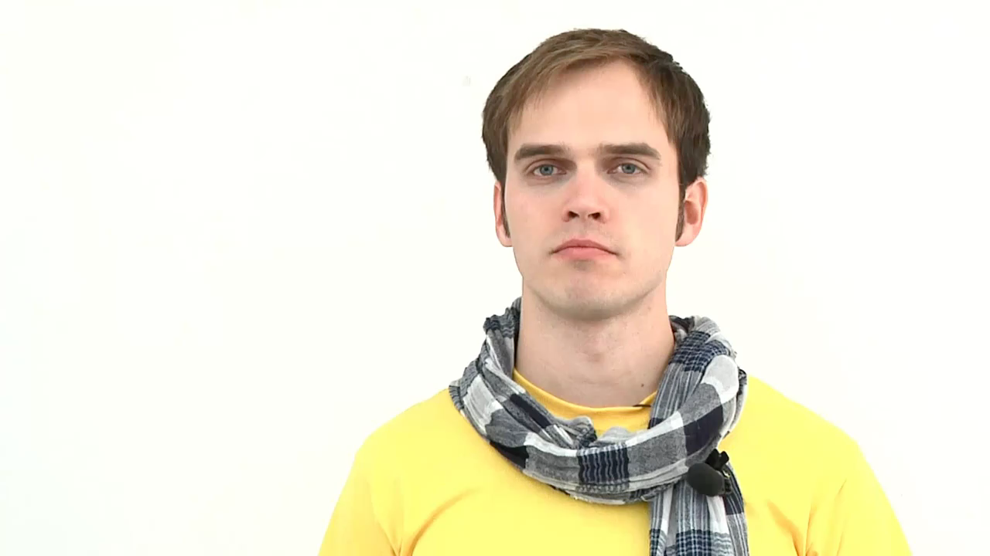
Source: openaccess.net

Slide 33
ScholarWorks
The promise and potential of future scholarship
  Increased access and visibility
  Increased collaboration
  Faster communication
  Long-term archiving
  Increased rates of citation

