Slide 1

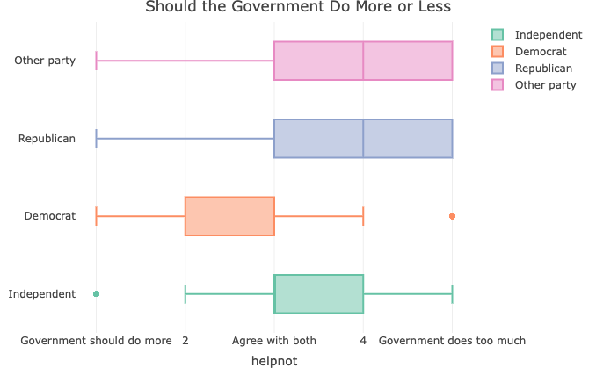
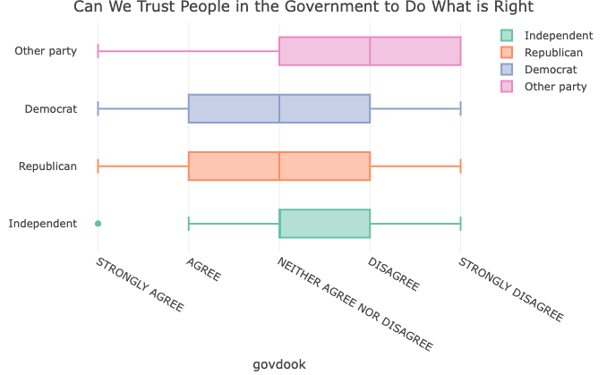
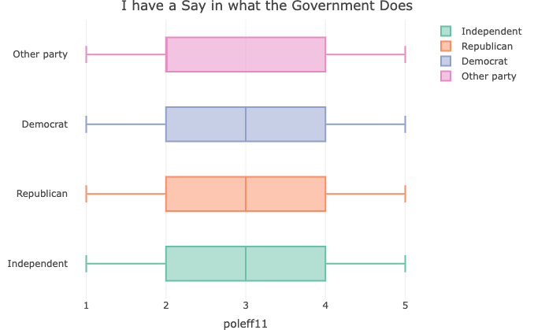
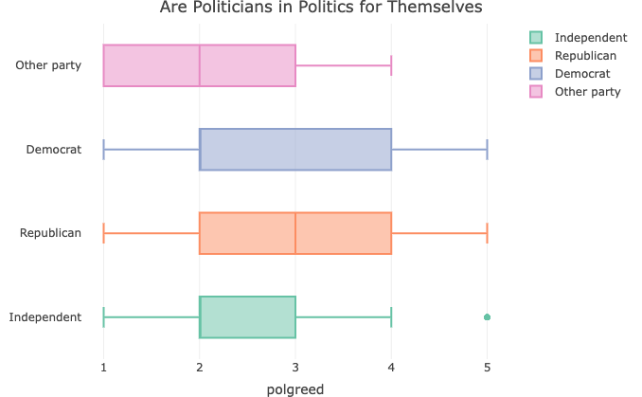
The Division of the American People Through Politics
Taylor Hall
Montana State University Billings; Dr. McMullen
Introduction
Results
Methods Continued
Procedure
Responses from the GSS for the above questions along with demographic data on participants from the years 2004 and 2014 were gathered and analyzed using RStudio.
One way ANOVAs were used to assess statistical differences between responses to these questions with affiliated political party as well as age with political party. A correlation matrix was ran to assess if there was any statistical significance between political party and sex.
Current political turmoil in the United States is evidenced by very divided viewpoints between political parties. This research analyzed data collected by General Social Survey in 2004 and 2014 to assess American people’s feelings toward the federal government and what political party they belonged to in an attempt to see if there were any significant statistical differences between party affiliation and beliefs surrounding the government.
Hypothesis
People will differ in their answers by political party, especially between Democrats and Republicans.
Of the 5,350 people surveyed 38.8% reported themselves to be Independent, 33.3% Democratic, 25.3% Republican and the rest as other party. Ages of participants ranged from 18 to over 70, with the majority of participants in their 40s (1,044). The majority of participants reported themselves to be either working class (44.3%) or middle class (44.4%).
jFigure 1 (left). Should Government Do more or less by political party.
1.Some people think that the government … is trying to do too many things that should be left to individuals and private businesses. Others disagree and think that the government should do even more to solve our country's problems.
Discussion
Methods
While the results did show a statistically significant difference between parties and responses, the most surprising finding was that that Democrats and Republicans differed less on some issues than those who marked themselves as Independent.
Notable findings
An analysis of variance showed a statistically significant difference between political party and how much participants felt their opinion mattered pertaining to what the government does, F(2)= 10.2, p= <.001. Republicans (M= 3.10, SD = 1.26) and Democrats (M= 3.03, SD= 1.28) rated more similarly on average than Independents (M= 2.84, SD= 1.29).
Additionally, an analysis of variance showed a statistically significant difference between political party and opinion on government aid, F(2) = 139, p= <.001. Republicans (M= 3.73, SD=1.16) and Independent's (M= 3.15, SD= 1.23) differed less on their responses than Democrats (M=2.68, SD=1.17).
Future research
With the results being with less of a difference between Democrat and Republican responses than hypothesized, this warrants a follow up study with more specific questions, potentially encompassing the reasoning for why they may disagree or agree with the statements in the survey. Another surprising finding was the majority of participants marked themselves as independent (N=2170) over Democrat (N=1784) or Republican (N=1358).
Participants
Data gathered from the General Social Survey(GSS) of 5,350 American people (54.7% female, 45.2% male) from the years 2004 and 2014 was analyzed, the data included age, sex, race, political party, religion and subjective social class data.
Measures
This study took data gathered in 2004 and 2014 in some GSS ballots that contained responses to the following questions:
1. "Some people think that the government in Washington is trying to do too many things that should be left to individuals and private businesses. Others disagree and think that the government should do even more to solve our country's problems. Still others have opinions somewhere in between. Where would you place yourself on this scale, or haven't you made up your mind on this?"
2. "To what extent do you agree or disagree with the following statements? Most of the time we can trust people in government to do what is right".
3. "How much do you agree or disagree with each of the following statements? ... People like me don't have any say about what the government does"
4. "To what extent do you agree or disagree with the following statements? Most politicians are in politics only for what they can get out of it personally".
Figure 2 (right). Trust in government officials
2. "To what extent do you agree or disagree with the following statements? Most of the time we can trust people in government to do what is right".
Figure3 (left). I have a say in what the government does
3. "How much do you agree or disagree with each of the following statements? ... People like me don't have any say about what the government does"
Figure 4 (left). Political motivation
4. "To what extent do you agree or disagree with the following statements? Most politicians are in politics only for what they can get out of it personally".
References
NORC. (2020). GSS Data explorer: NORC at the University of Chicago. GSS Data Explorer | NORC at the University of Chicago. https://gssdataexplorer.norc.org/MyGSS
Posit team (2024). RStudio: Integrated Development Environment for R. Posit Software, PBC, Boston, MA. URL http://www.posit.co/.

