Slide 1
All Aboard!
The Party’s Starting
Setting a Course for Social Media Success

Slide 2
Mary Anne Hansen
@montanamah
Doralyn Rossmann
@doralyn
Angela Tate
@angelamtate
Scott Young
@hello_scott_

Slide 3
Presentation Outline
What is social media and why should you care?
How we use social media at MSU
Our guidelines and goals
Strategic planning integration
Social media beyond the library

Slide 4
Social Media
Notes:
Scott begins

Slide 5
Social Media is
Community
Notes:
Scott begins

Slide 6
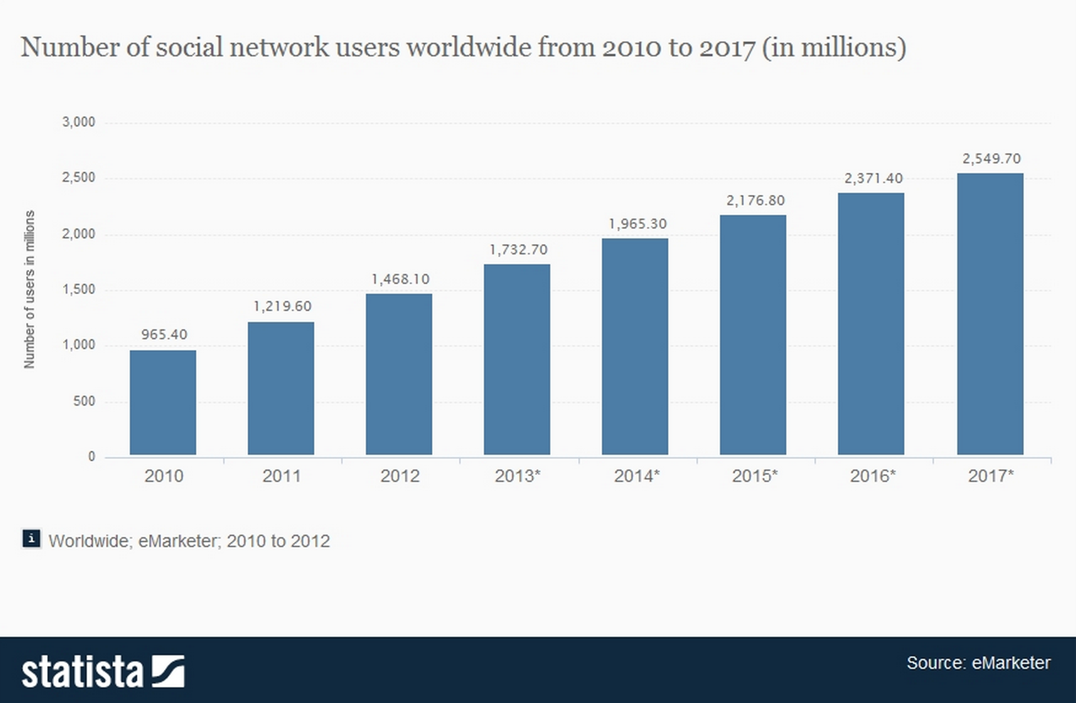

Slide 7
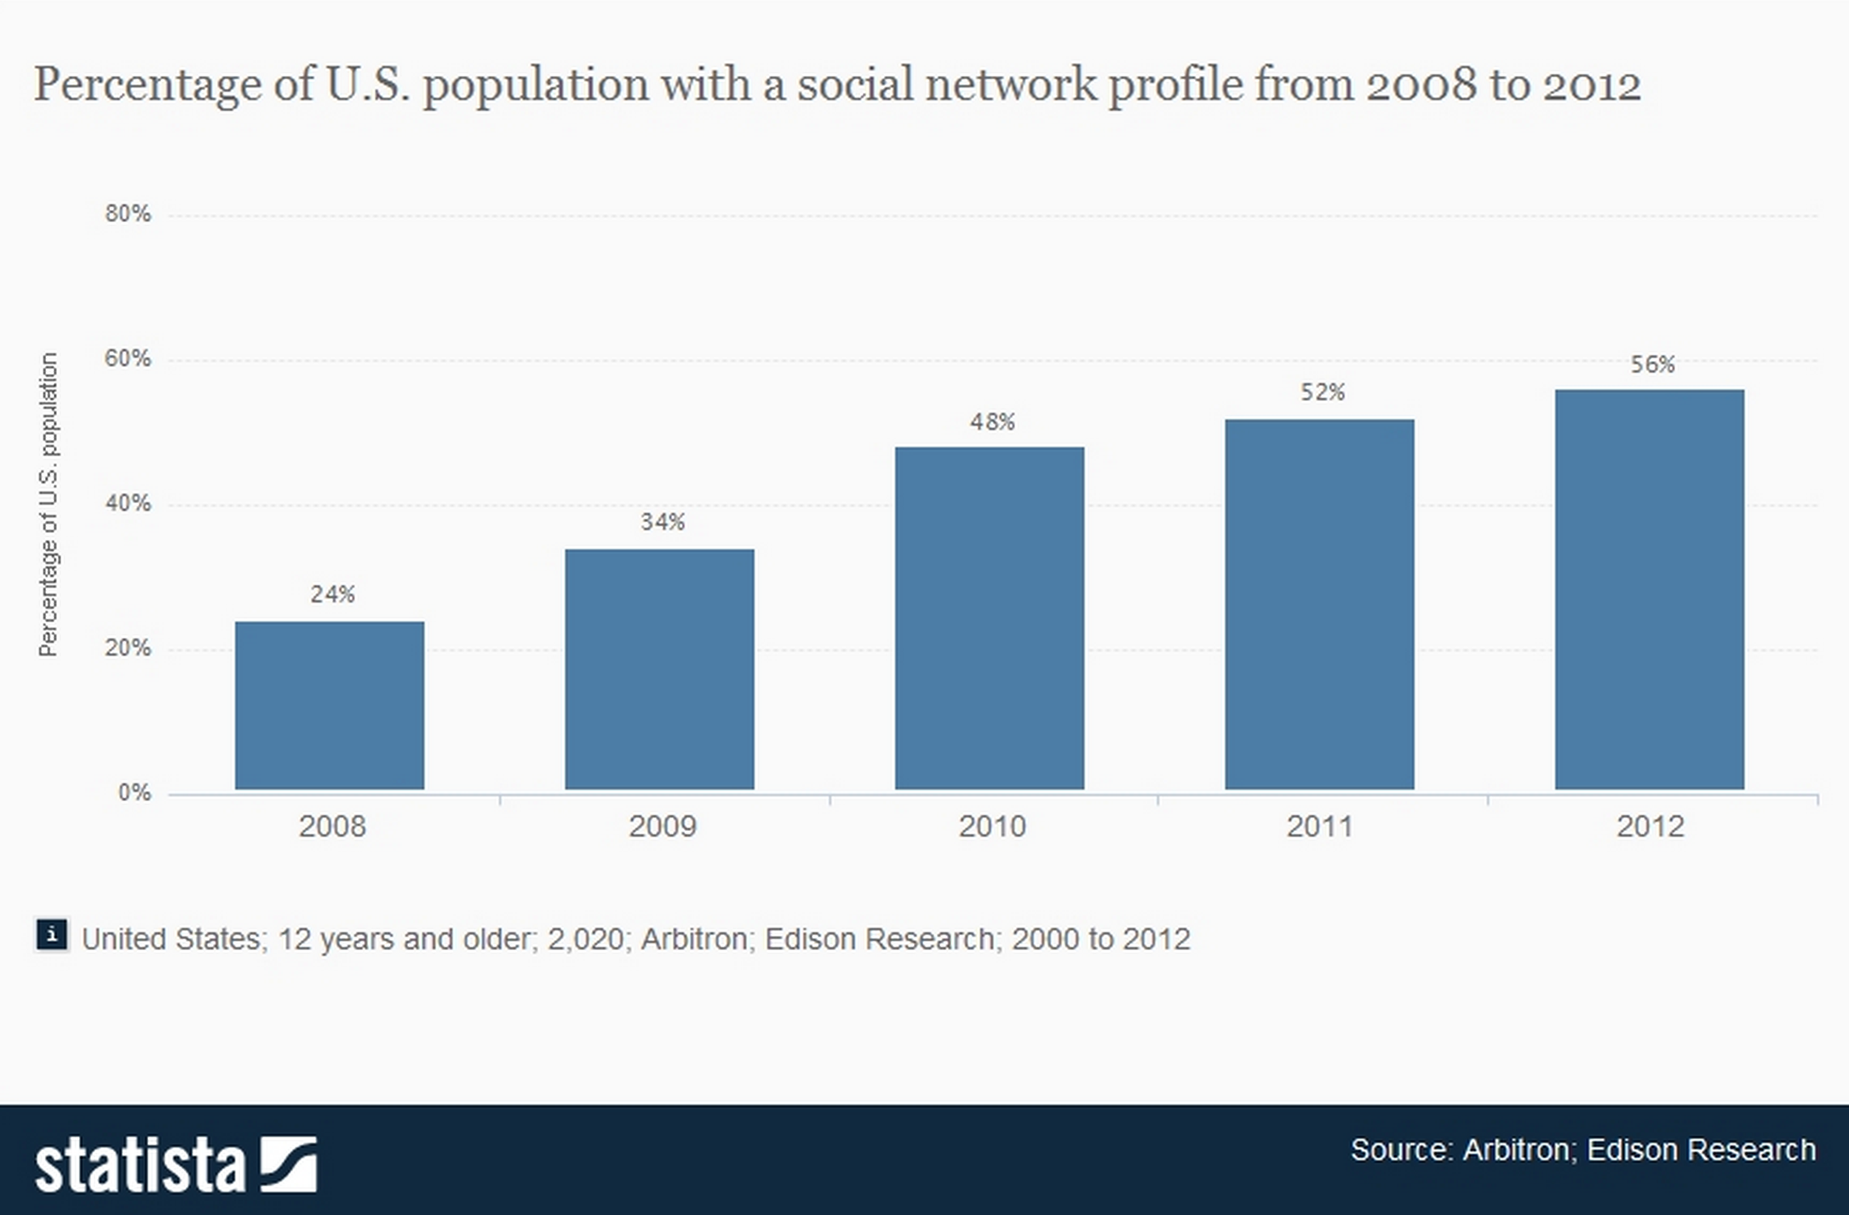

Slide 8
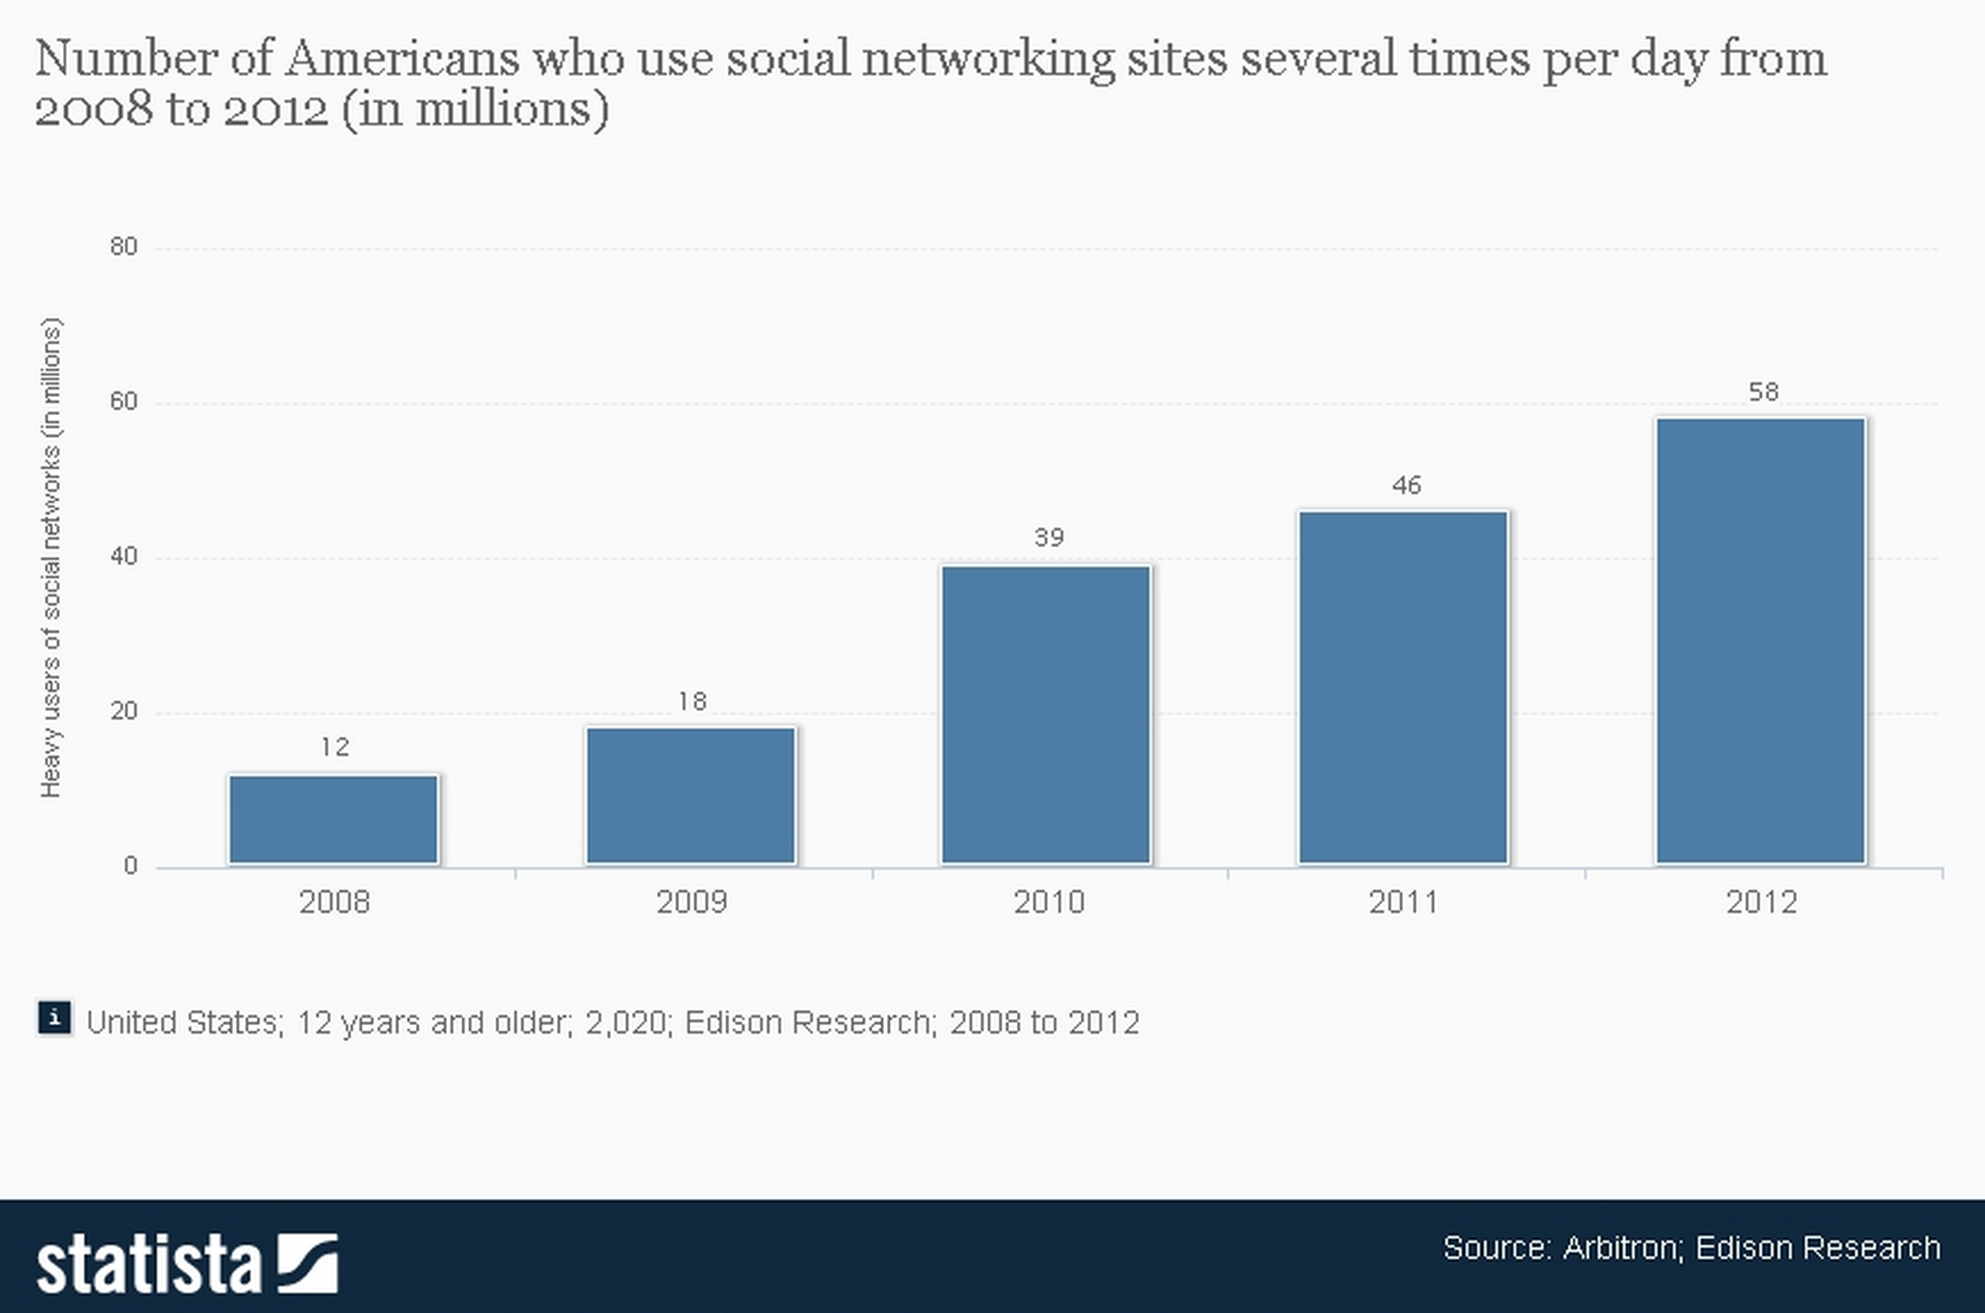

Slide 9
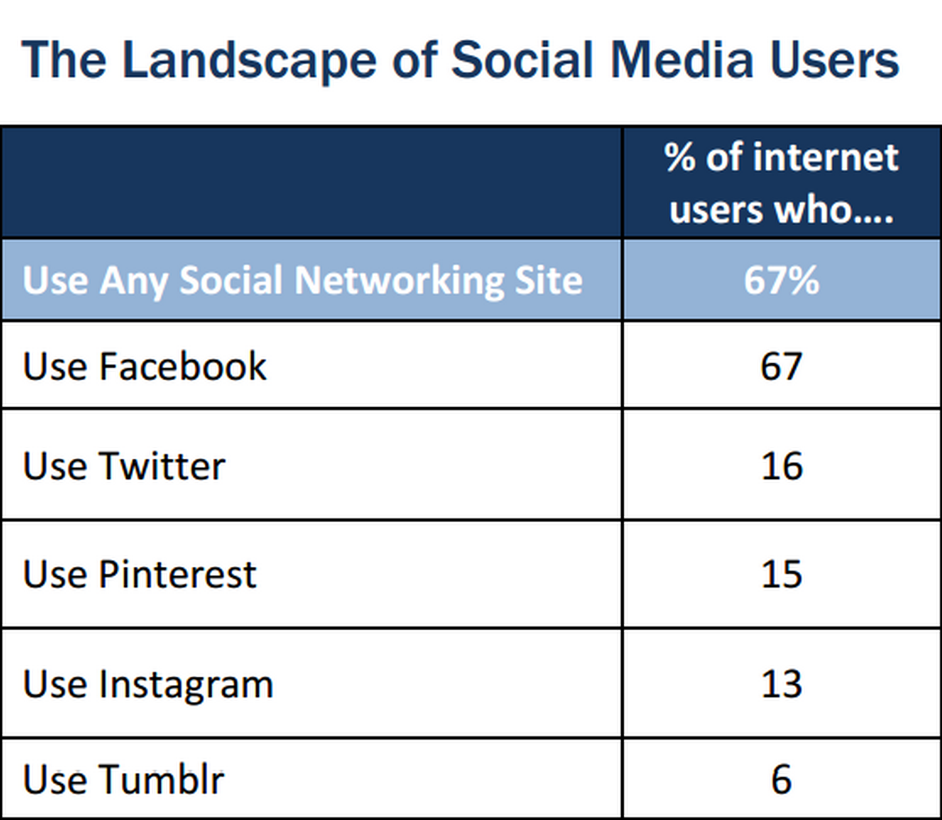
http://www.pewinternet.org/~/media//Files/Reports/2013/PIP_SocialMediaUsers.pdf

Slide 10
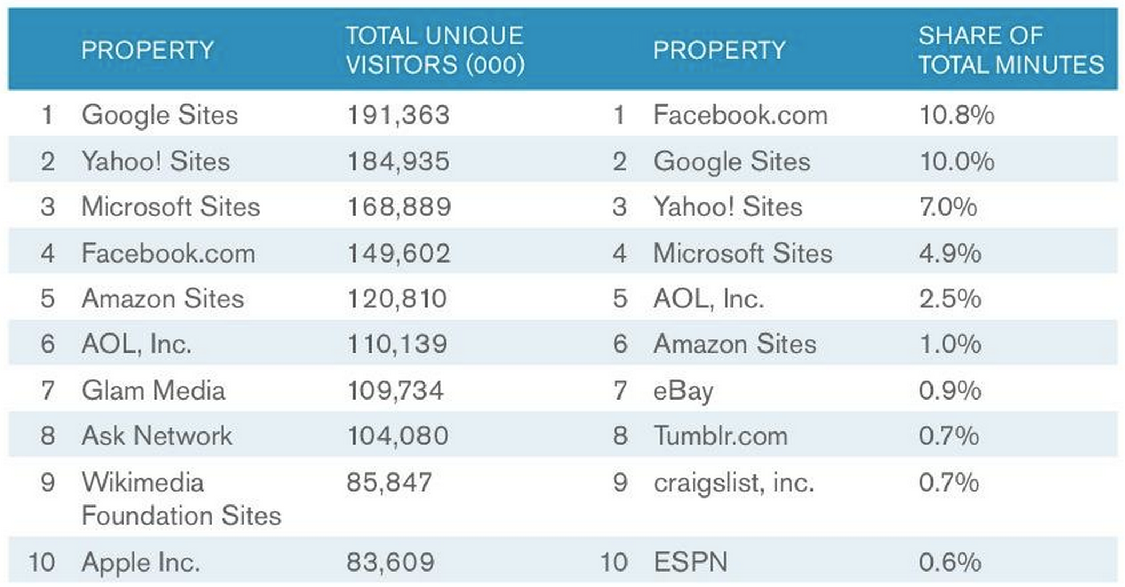
Top Web Properties
Source: comScore Media Metrix, U.S., Dec-2012

Slide 11
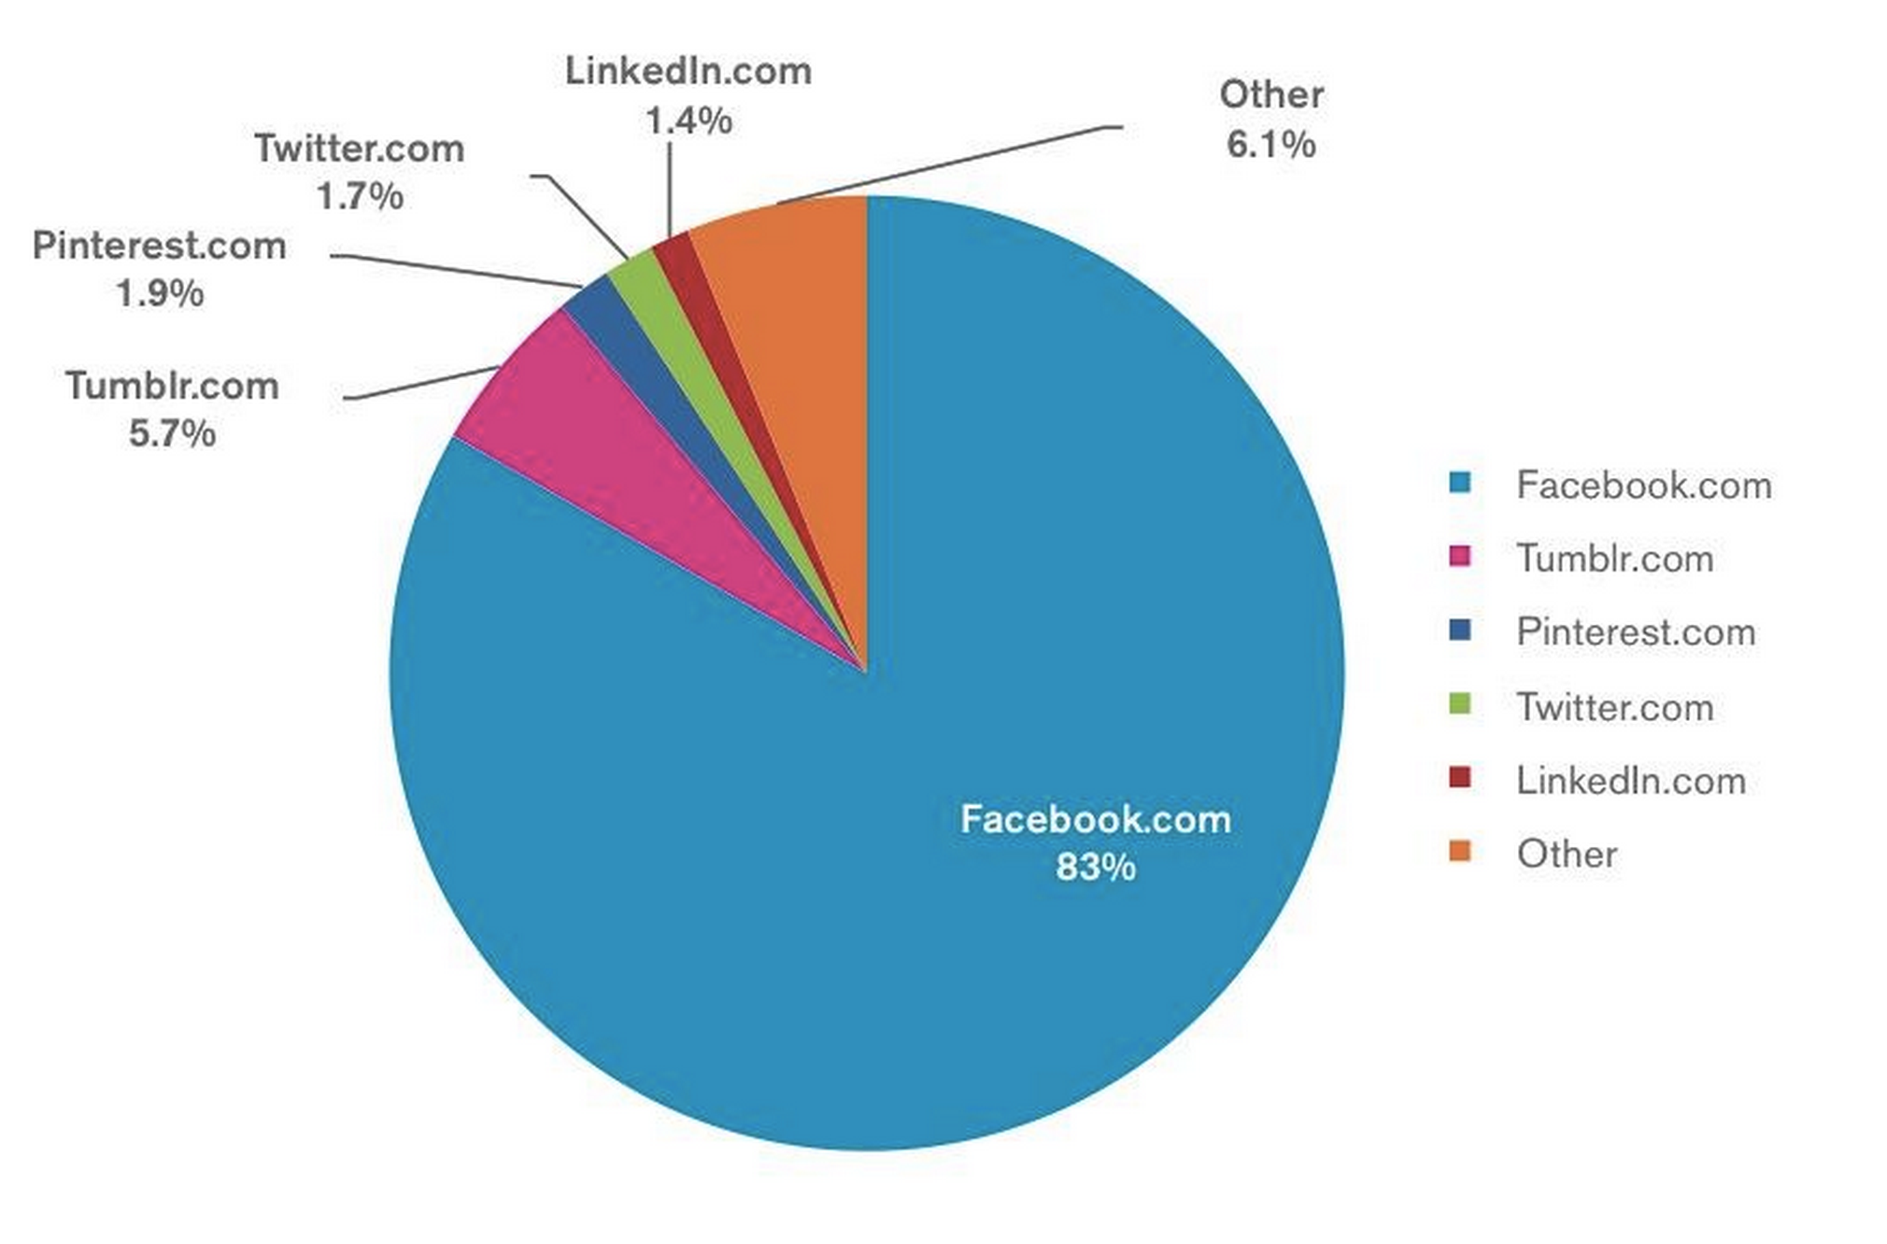
Share of time spent on social networking sites
Source: comScore Media Metrix, U.S., Dec-2012

Slide 12
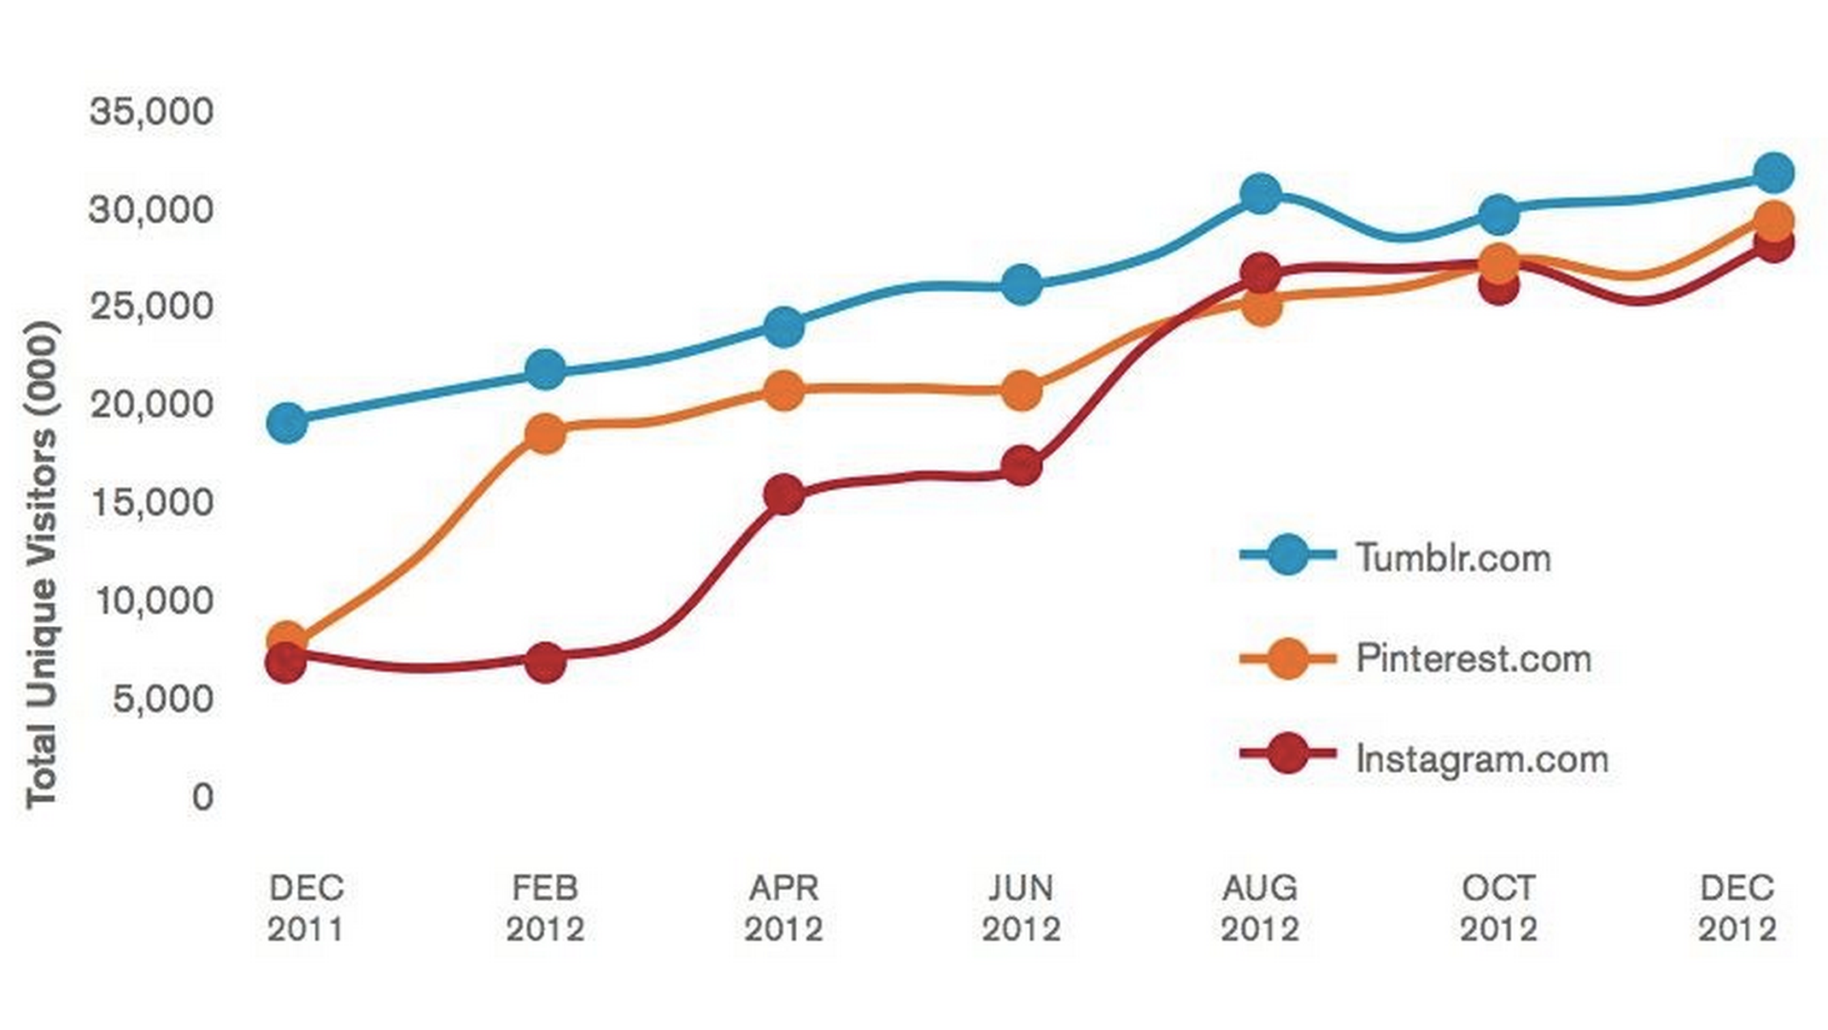
Total Unique Visitors Trend
Source: comScore Media Metrix, U.S., Dec-2011 to Dec-2012

Slide 13
What does this all add up to?

Slide 14
New Opportunities
To connect through social media
To build an (online) community of library users
Notes:
Through this vast network of connected users, libraries have new opportunities:

Slide 15
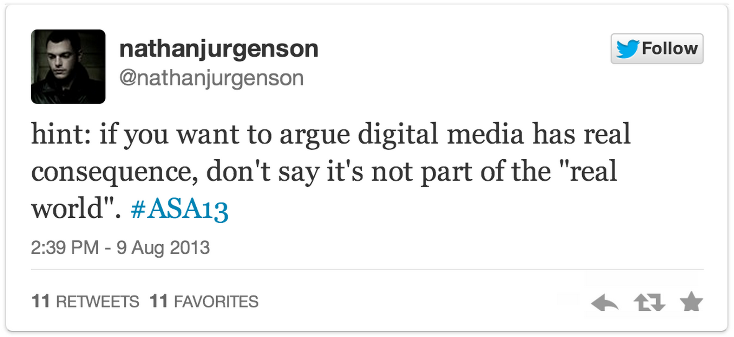

Slide 16
Digital media has real consequence

Slide 17
The online world is the real world

Slide 18
The (Online) World of 2013
Libraries and librarians are online
Users are online
Libraries can connect directly to users online through social media

Slide 19
Social media offers new ways to connect
Notes:
New network access

Slide 20
Connection is community

Slide 21
Community-building is a process
Have a plan
Be committed
Notes:
Hand off to Angela

Slide 22
MSU Library Social Media Group
Recognized an opportunity
Strategically formed our group
Notes:
Angela’s Slides

Slide 23
MSU Library Social Media Group
Recognized an opportunity
Strategically formed our group
  Lead contacts
  Library representation
  Interest and commitment

Slide 24
MSU Library Social Media Group
Recognized an opportunity
Strategically formed our group
Created goals and guidelines
Notes:
Angela’s Slides

Slide 25
The Social Media Guide
Provides a plan
Provides accountability and transparency
Communicates purpose and process internally and externally
Notes:
Scott Begins

Slide 26
The Social Media Guide
Audience focus
Goals
Values
Tone and Tenor
Focus and frequency of posts
Posting categories
Posting personnel
Assessment
Notes:
Hand off to Angela

Slide 27
Facebook
our practices
Notes:
Angela Begins

Slide 28
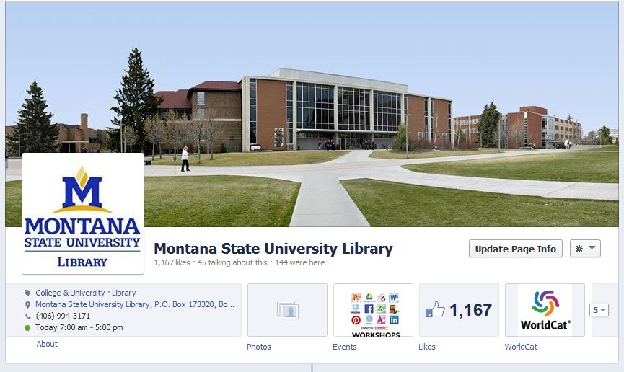

Slide 29
Audience
Undergraduate student population; greater Bozeman community

Slide 30
Goal
Increase undergraduate and community awareness and use of library services and resources; cultivate an inviting online personality; create a Facebook page that can serve to extend the Library’s services and community activity

Slide 31
Values
Intellectual curiosity; information sharing; undergraduate learning; book reading; use of web-based information-related technology; community building; friendly and accessible library service

Slide 32
Tone & Tenor
Welcoming, warm, cheerful, energetic

Slide 33
Focus & frequency of posts
Balance of information sharing and social interaction
1-5 posts per day, with monitoring of subsequent interactions

Slide 34
Twitter
our practices

Slide 35
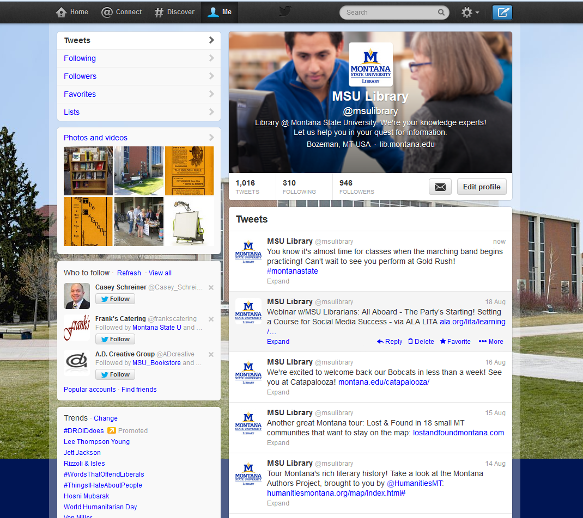
Notes:
Doralyn Begins

Slide 36
Audience
Undergraduate and graduate students; other MSU units/departments; library and information professionals and organizations

Slide 37
Goal
Build an online community of library-supporters via social media engagement, accomplished through regular interactions with students and others on Twitter; form partnerships through mutual support of other MSU entities via Twitter; engage and connect with other libraries, librarians, library organizations; Increase awareness of library services, resources

Slide 38
Values
Availability to help students; care/concern for followers; professional engagement; scholarly research; specialized library services and resources

Slide 39
Tone & Tenor
Kind, fun, engaged, knowledgeable, professional, conversant

Slide 40
Focus & frequency of posts
Emphasis information sharing and social interaction
5-10 posts per week, with regular monitoring of subsequent interactions; no automatic posting – tailor wording of posts for community and 140-character limitations; can schedule in advance through HootSuite; commenting on other’s Twitter posts, retweeting, and favoriting as appropriate

Slide 41
Categories
Events, news and other content that focuses on matters important to students who use the library
Original library content: Blog posts (ideally 1 per month), “Tip of the Week,” “Think Tank,” Tumblr posts
Services and Resources: New databases, current databases and guides, ask-a-librarian

Slide 42
Tumblr
our practices
Notes:
Scott Begins

Slide 43
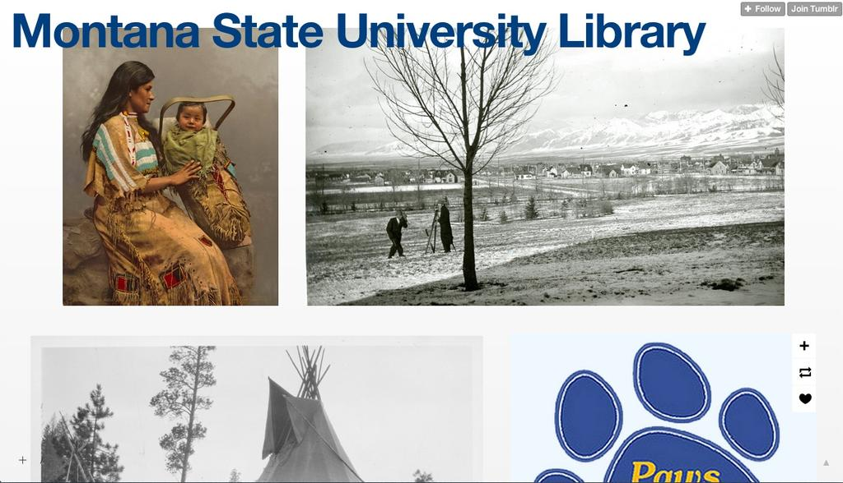

Slide 44
Audience
Montana-wide community, with a focus on state and local culture and history

Slide 45
Goal
Increase awareness of Library collections

Slide 46
Values
Primary source engagement; visual engagement; book reading

Slide 47
Tone & Tenor
Light-hearted, casual, experimental

Slide 48
Focus & frequency of posts
Emphasis on information sharing while remaining responsive to social interaction
3-5 posts per week

Slide 49
Categories
Highlights from the Library catalog, Special Collections, and University Archives

Slide 50
Pinterest
our practices
Notes:
Angela Begins

Slide 51
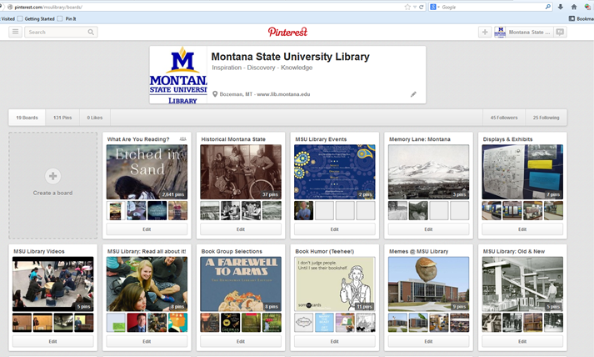

Slide 52
Audience
Montana-wide community; libraries and librarians; book lovers and western history enthusiasts

Slide 53
Goal
Increase awareness of Library collections; engage and connect with other libraries and library users; extend our inviting online community

Slide 54
Values
Primary source engagement; visual engagement; book reading

Slide 55
Tone & Tenor
Light-hearted, casual, experimental, fun

Slide 56
Focus & frequency of posts
Emphasis on information sharing while remaining responsive to social interaction
1-3 posts per week

Slide 57
Categories
Resources: Highlights from the Library catalog, Special Collections, and University Archives
Community-building: Internet content for book and library lovers

Slide 58
Strategic Plan Integration
Make it official

Slide 59
MSU Library Strategic Plan
ENGAGEMENT
MSU Objective
E.1: Strategically increase service, outreach and engagement at MSU.
Library Strategy
Develop a library-wide coordinating structure to support and advance Library engagement, outreach and service.
Library Objective
(Matches the MSU Objective.)
Library Metrics
3) Continue to develop engagement with social media networks for the MSU Library community by 2019.
Target/Milestone/Lead Team or group
      Explore emerging social media networks and trends that engage library users – Social Media Group & DAWS
      Apply innovative uses of social media to increase online interaction with the Library by 2015 – Social Media Group & DAWS
      Conduct research involving student and community social media usage and track results by 2016 – Social Media Group

Slide 60
Social Media Group Strategic Plan
Explore emerging social media networks and trends that engage library users
SMG Goals:
  Instagram: develop user-generated content program
    take our iPod touch for a day during finals week
  Foursquare, Pinterest, Yelp, and Google+
  Found a “Social Media Center” based in the library that serves the campus community
    lead social media development across campus through workshops, research, and best practices

Slide 61
Social Media Group Strategic Plan
Apply innovative uses of social media to increase online interaction with the Library by 2015
SMG Goals:
  Create and distribute a monthly digest to inform library employees of social media successes and promote social media platforms
  Increase student involvement on SMG
    student suggestion of the week
    student voice on SMG
    develop social media internship

Slide 62
Social Media Group Strategic Plan
Conduct research involving student and community social media usage and track results by 2016
SMG Goals:
  Facebook advertising
  Online communities in an academic context, particularly through Twitter
  Social media assessment (Assessment in Action)

Slide 63
Becoming a social media leader
Lead and educate your peer organizations
Notes:
Mary Anne and Doralyn

Slide 64
Becoming a social media leader
Teach workshops
  general
  a specific SM technology
Organize SM events
  Social Media Summit
  Brown bag discussions
Promote best practices

Slide 65
Becoming a social media leader
Strategize with groups across campus and community
  Web Communications or umbrella organization leadership
  Start a Community Social Media Group to share ideas
  Integrate related Library entities for a unified voice rather than disparate accounts (FOL)

Slide 66
Becoming a social media leader
Talk with users of social media to understand better how they are using social media
Find out what they would expect from the Library’s social media in terms of types of posts
Find those who represent the people you’re trying to reach

Slide 67
Assessment
Notes:
Scott

Slide 68
Student Focus Groups
“Organizations are sort of notoriously bland on their social media accounts, because everything you say represents the entire organization and it’s very hard to be edgy or funny when you have the organization’s face attached to it.”

Slide 69
Student Focus Groups
Q: How important is the idea of personality for social media?
A: It’s essential.
A: It’s huge. Which again, I think, coming back to campus and coming back to the library, the library and the Rocky G has personality, and that’s why people follow it

Slide 70
Student Focus Groups
“Shareability is so important.”

Slide 71
Student Focus Groups
Q: That level of interaction enabled by social media leads in a way to a greater feeling of connection with the library? In that example.
A: Mmhm.

Slide 72
Student Focus Groups
“If you have a Twitter account, you have to give people a reason to follow you. I think a lot of entities at MSU don’t understand that. The library does an awesome job. You guys give people a reason to follow you. You’re responsive. You’re clever. Interesting. And it’s not just event updates. And I’m serious. I really admire all of the social media at the library.”

Slide 73
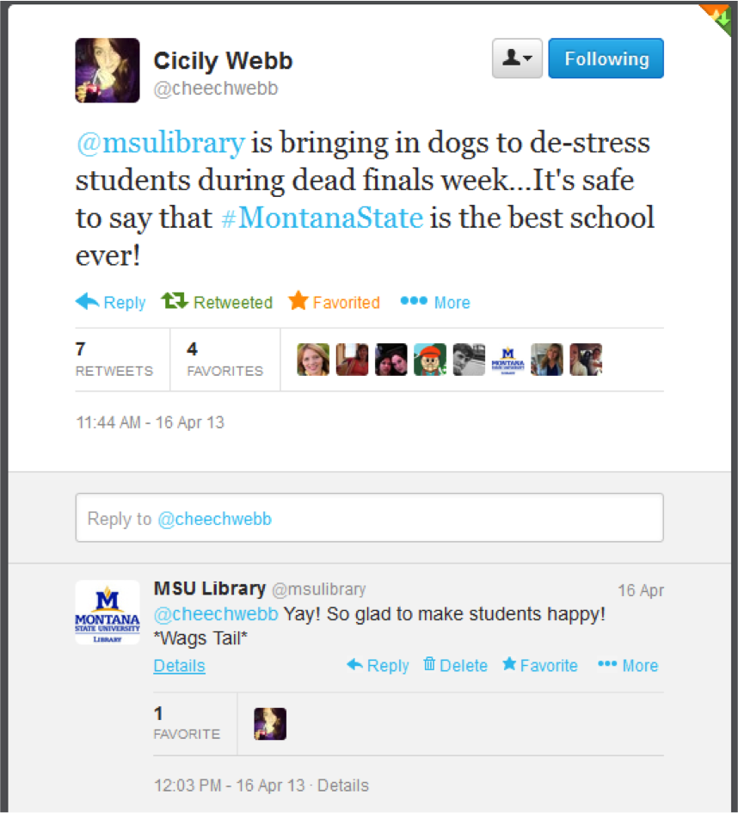
Notes:
Doralyn

Slide 74
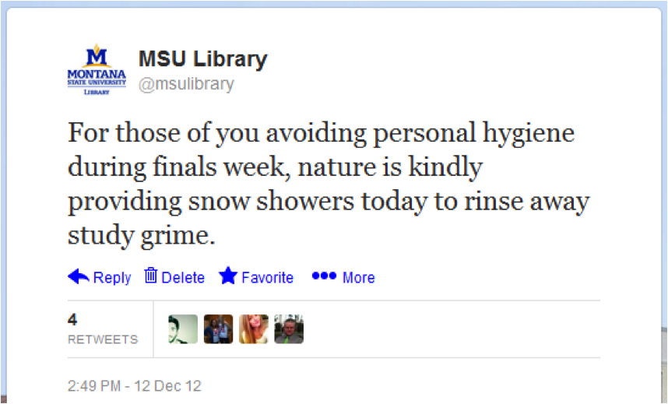

Slide 76
Final Thoughts
Have a plan
Be committed
Consider personality
Consider shareability
Be responsive to your community: engage!
And finally: have fun!

Slide 77
Thank You!

Slide 78
Questions and follow-up
@doralyn
@angelamtate
@hello_scott_
@montanamah

