Slide 1
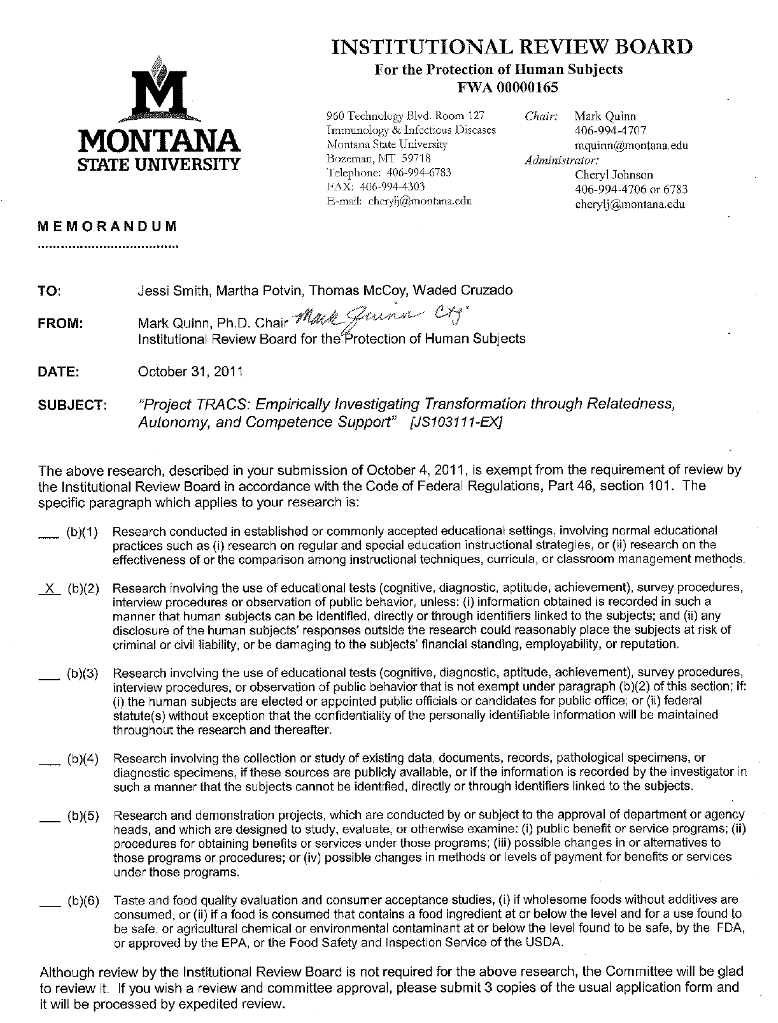
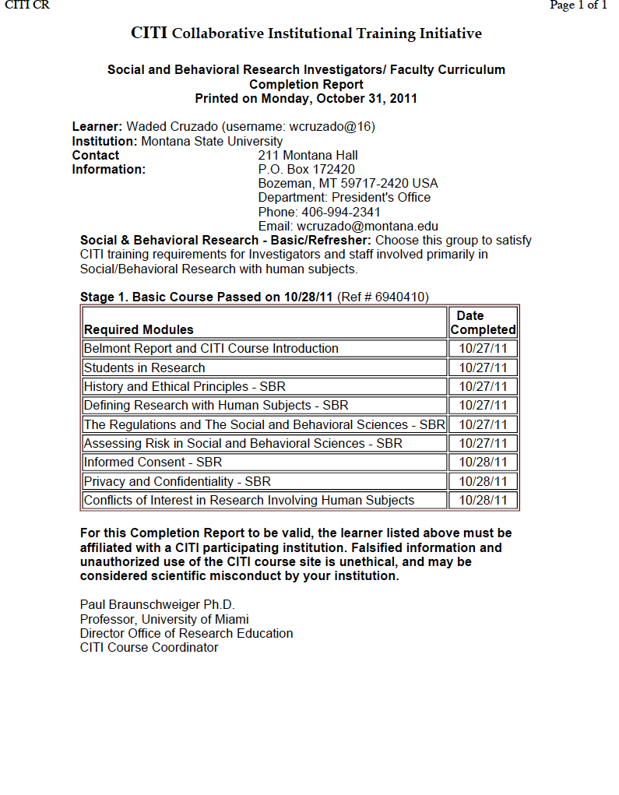
Methodological Information
Research Objective 1: Test the extent to which institutional, departmental, and individual markers predict gender cultural transformation among MSU faculty and administrators
Research Objective 2: Test the dynamic and complex ways in which fostering competence, autonomy, and relatedness needs can bring about cultural transformation at MSU.
All Social Science Team Members and Co-PIs undergo CITI Ethical Training and Project is IRB approved
Interviews with Job Candidates:
AIM: Hear perceptions of the search process and determine emergent themes related factors important to decision to accept/decline offer at MSU
N = 12 candidates (6 men and 6 women) in STEM/SBS have been interviewed to date (n =7 who declined the offer; n = 5 who accepted the offer). Interviews scheduled with 6 additional candidates; 3 accepted, 3 declined (5 women and 1 man.)
Final goal: N=18.
Baseline Climate Survey
AIM: Assess men’s and women’s perceptions of job satisfaction, inclusion, relatedness, autonomy, and competence need-satisfaction at the onset of the project as a baseline to examine transformation over time as a function of Project TRACS initiatives
N = 350
Validated Surveys IRB approved
October 11, 2012 Baseline
Survey Monkey Invitation
50 randomly selected participants receive $50 giftcard
Everyone Receives $5 Coupon to the Daily Coffee Shop
Annual Transformation Survey
October 2013
October 2014
October 2015
October 2016
Interview Protocol for TT Faculty Job Candidates EXCERPT
Opening: Hello ___________. This is Joy Honea; I emailed you recently about your willingness to discuss your experiences when interviewing for _______________ position at MSU. I really appreciate your time; we are working on better understanding the reasons why potential faculty make the decisions they do regarding coming to MSU or not. Your input is keenly valuable to us in our continued efforts to improve our University. Oral Consent: A Consent form was provided to you in the email invitation, but I do want to reiterate that you will remain completely anonymous in any written reports that come out of this study, and your responses will be treated in the strictest confidence. Your information will be identified by a code number only. Do you give consent to participate in this interview? Great! I was hoping that I could also record this interview, so we can go back later and make sure we represent your answers correctly. The recording will be erased once our interview has been transcribed. As with all research, confidentiality could be breached if someone captures the voice recording of our conversation. I assure you that I will make every effort to insure that will not happen: the voice recording will be stored on a password-protected computer and will be erased as soon as it is transcribed. Your name will not appear anywhere on the transcription document. Would recording this interview be alright with you? Transition: Other than the fact that there was a position open in _______________ department, was there anything in particular about MSU that prompted you to apply for the position? {may use probes here to describe factors identified} Key: After your campus interview, you were offered the position, and you decided to ___________________________. Can you describe the factors that led to your decision? Key: MSU recently was awarded an NSF ADVANCE grant, intended to transform culture to foster success of women and minorities in STEM disciplines. While culture is hard to define, we know it when we experience it. What was your sense of MSU’s culture? {probe about culture and women faculty if necessary}
Fall 2012 Baseline Survey Response Rates
Department Diversity, Equity, and Inclusion Self-Study
AIM: Engage departments in thinking about equity to identify best practices and offer resources/support to reach department-set goals
N = 33
Department Annual Diversity, Equity, and Inclusion Self Study Worksheet Excerpt
What is the department’s mission regarding equity, diversity, and inclusiveness? What does the department see as the biggest challenge they face to promoting equity, diversity, and inclusiveness? What are the department’s greatest strengths and successes in broadening the participation of women?

Slide 2
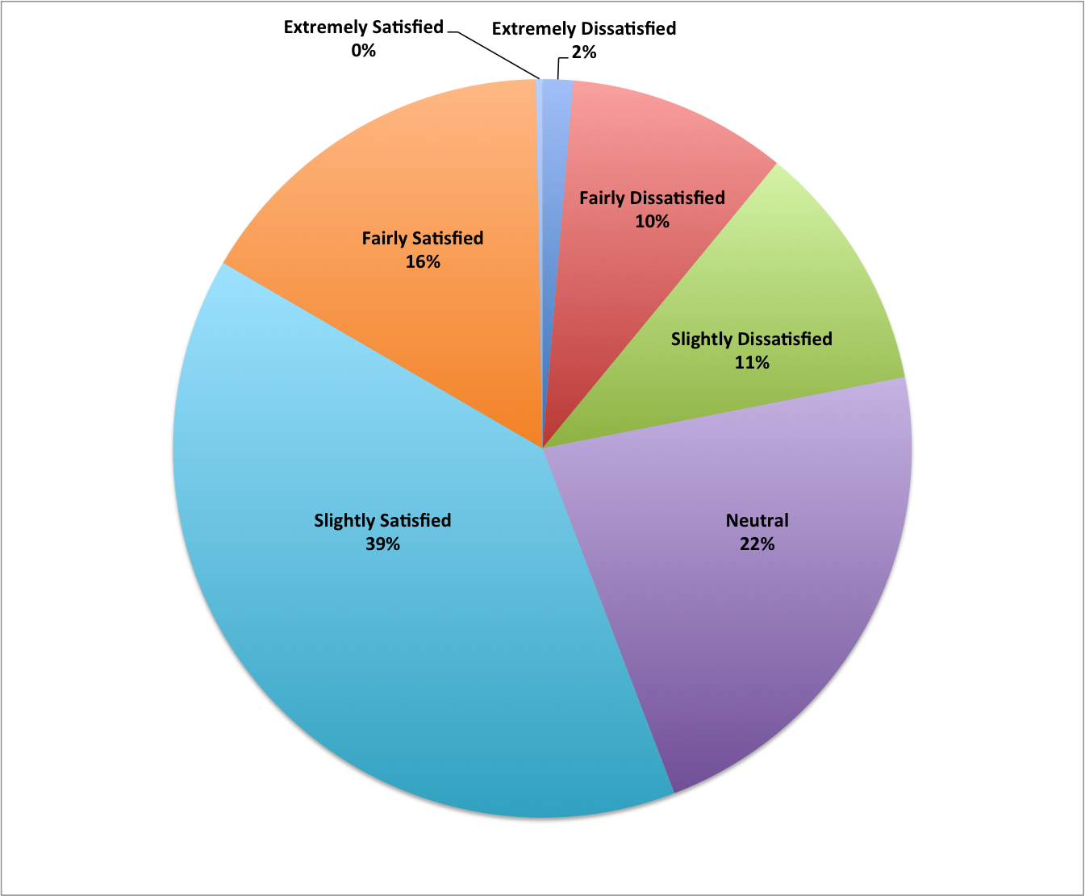
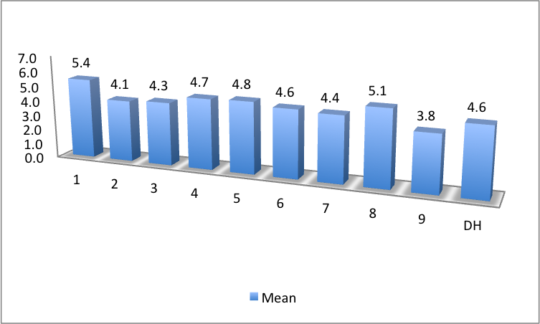
Overall Job Satisfaction
Baseline Survey Results
Participating Colleges (in Alphabetical Order) N=number of participants
Arts & Architecture 27 (49.1%)
Agriculture 52 (55.9%)
Business 15 (62.5%)
Education, Health & Human Development 24 (57.1%)
Engineering 47 (68.1%)
Extension 18 (40.0%)
Gallatin College 8 (66.7%)
Library 8 (57.1%)
Letters and Science 88 (54.0%)
Nursing 12 (63.2%)
To Consider: What can your college do to increase job satisfaction?
To Consider: Why might there be significant differences by college?
11 Item Survey of Job Satisfaction
-Majority of Faculty and DHs are slightly satisfied
-Highly internally reliable scale (Cronbach’s alpha = .88)
-No differences by position or rank
-No gender differences
-Significant differences between the colleges (F(1,9) = 2.75, p <.01)
Scores could range from
1 Extremely unsatisfied to
7 Extremely satisfied.
All means scores by college were at (4) neutral or above
College unnamed; number randomly assigned

Slide 3
Self-Determination Theory
Psychological Need Support and Job Satisfaction
Baseline Survey Results
Autonomy
r =.68*
β = .47*
Competence
r =.49*
Relatedness
r =.59*
β = .28*
β = .16*
Autonomy
Competence
the belief that one has the ability to influence and master important outcomes
Relatedness
the experience of having satisfying and supportive social relationships and connections
the experience of acting with a sense of choice and volition and fully embracing one’s actions.
Definitions
Job Satisfaction
Summary of Results
  Autonomy, Competence, and Relatedness each uniquely and significantly relate to Job Satisfaction.
*p<.001
  Together, these three variables account for 56% of the variability in Job Satisfaction, and significantly predict Job Satisfaction in a regression model, F(3, 282) = 121.54, p < .001.
Variable | Other Correlations with Job Satisfaction
Perceptions of Quality of Supervision | .35*
Perceptions of General Health | .20*
To Consider: When have you felt the most autonomous, competence, and/or relatedness supported?
To Consider: Why does autonomy support have the strongest association with Job Satisfaction?
Notes:
BE READY WITH CORRELATIONS AMONG THE NEEDS (SEE DATA OVERVIEW FILE IN DROPBOX)

Slide 4
Equity and Autonomy:
Gender Matters
Figure 1. Feelings of Gender Equity
Figure 2. Feelings of Autonomy
To Consider: What does disagreeing with these statements mean?
Figure 1 ANALYSES
-2(gender) by 2(stem_sbs or not) ANOVA
-Main effect of participant gender on perceptions of gendered treatment (F(1,274) = 36.07, p<.001).
-Compared to women, men significantly more likely to agree that MSU provides equal gender opportunities for achievement.
-No reliable differences by type of department
Figure 2 ANALYSES
-2(gender) by 2(stem_sbs or not) ANOVA
-Main effect of participant gender (F(1,276) = 3.80, p=.05) on overall feelings of autonomy support
-Compared to women, men significantly more likely to agree that they feel autonomously supported at work
-Main effect of department type F(1,276) = 6.43, p<.05)
-Compared to faculty in STEM/SBS Departments, those in non-STEM/SBS departments feel less autonomous.

Slide 5

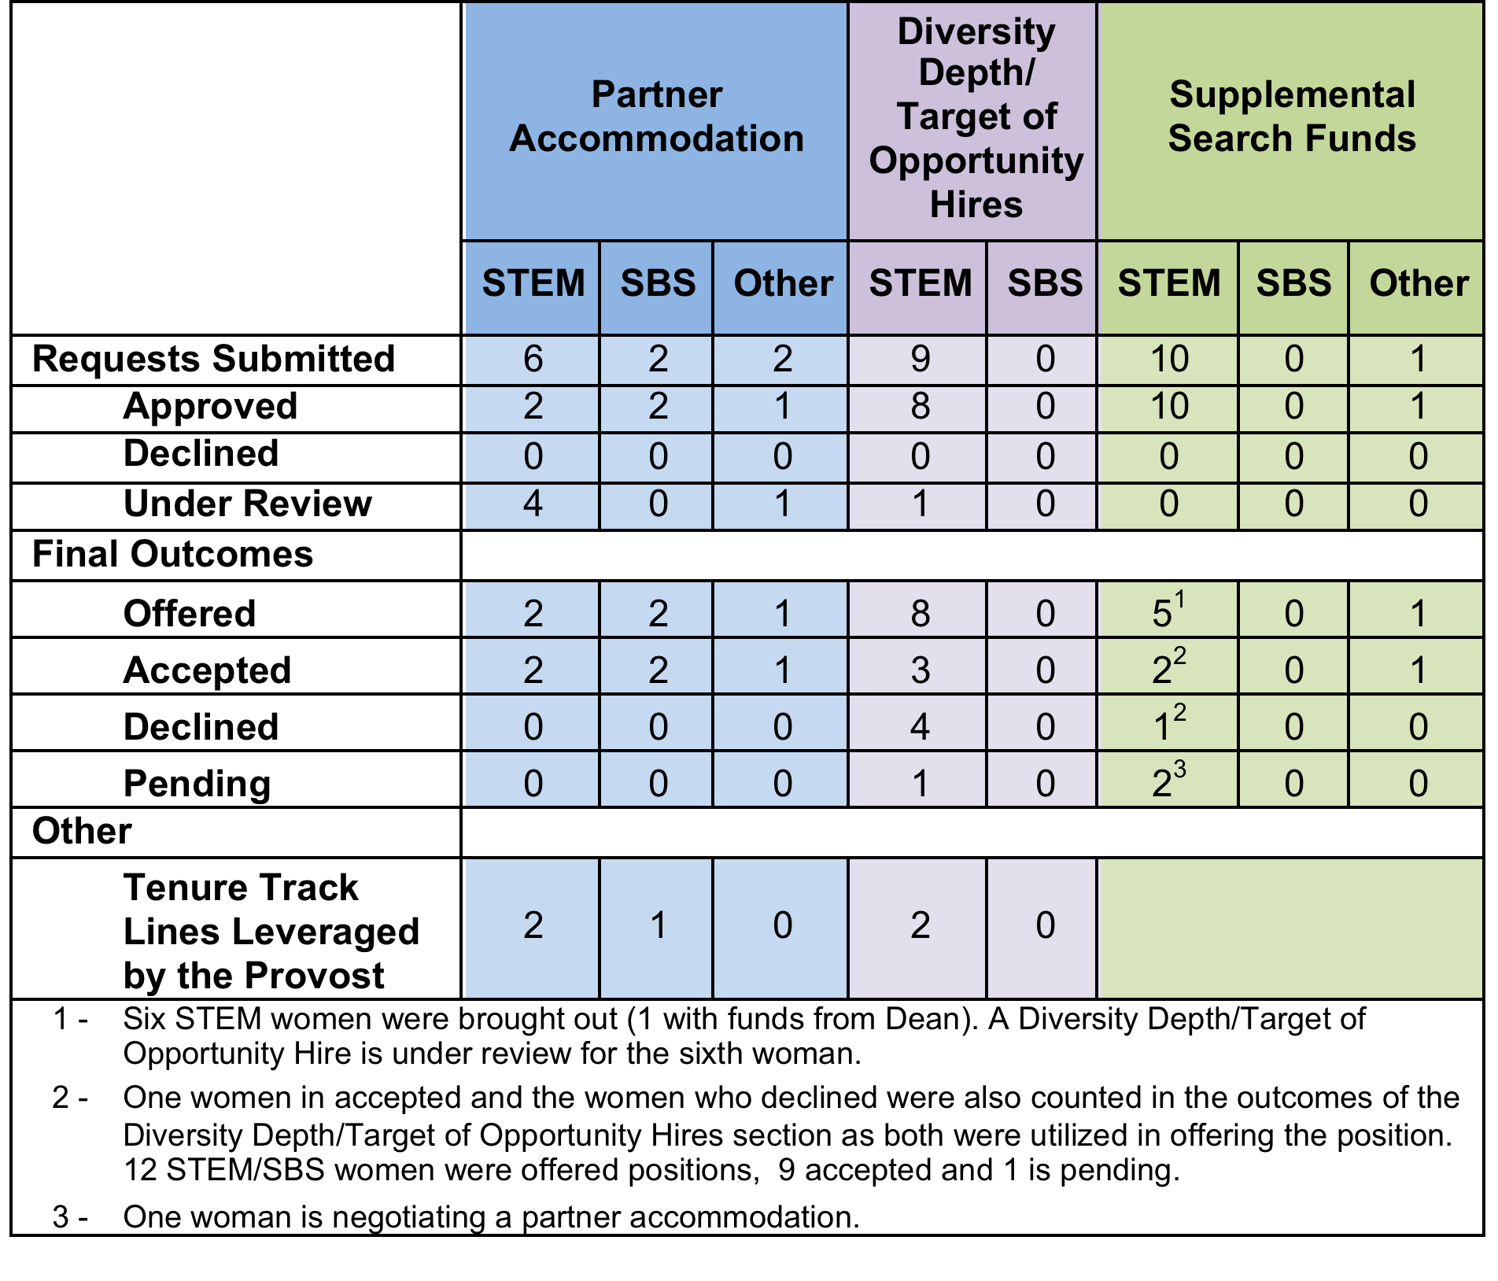
Broadening the Search Process:
Toolkit and Interview Results
Interviews with Subset of Candidates who Accepted or Declined
Selected ADVANCE Search Toolkit suggestions:
Bring more women to campus to interview (request supplemental search funding if needed)
Identify an outstanding woman candidate from an on-going search and request a Target of Opportunity hire by leveraging a future line
Support work-life integration by providing information (e.g., meet with the family advocate) to all candidates about work-life integration
Enhance recruitment of top candidate by working creatively to make partner accommodations
Most common reasons for accepting offers:
Positive impression of MSU/department (4 of 5)
Liked geographic location (3 of 5)
Spouse/partner found employment (2 of 5)
Attractive start-up package (2 of 5)
Most common reasons for declining offers:
No employment opportunity for spouse/partner (3 of 7)
Spouse/partner did not want candidate to accept (3 of 7)
Geographic location- expensive, difficult for travel (2 of 7)
Received a more attractive offer (2 of 7)
Evaluation of work-life integration initiatives:
100% positive evaluation of meeting with family advocate
  Representative comments:
    “I loved the family advocate meeting!”
    “It made me feel more comfortable asking about (work-life integration.)”
100% positive evaluation of work-life integration initiatives
  Partner employability identified as the most important initiative, followed by childcare availability and family leave options.
  Initiatives regarded as beneficial in the abstract, though few candidates identified them as personally relevant at the present time.
  Representative comments:
    “MSU is the only place that talked about any of these issues.” (Echoed by all 12 respondents.)
    “We need to catch up to Bozeman!”
70
The number of job candidates who had an in-person meeting with the University Family Advocate (Sara Rushing)
To Consider: How can we better accommodate partners?

Slide 6
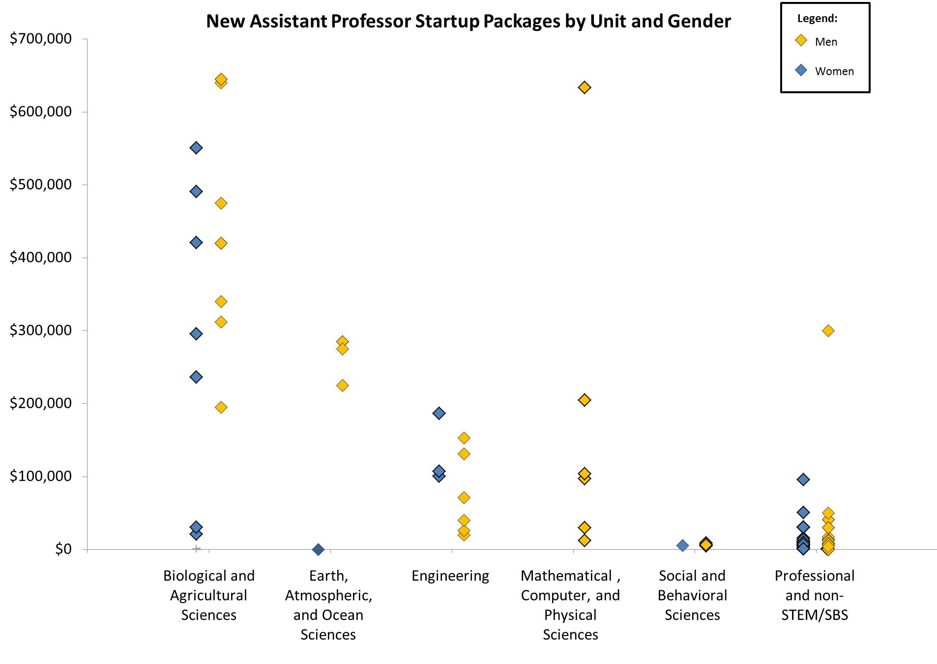
Institutional Data:
Baseline Indicators
2010-2012 Start-Up Packages
2008-2012 Voluntary Termination:
Proportion of faculty who leave their departments, excluding those who died or retired, by gender and STEM/SBS or Non-STEM/SBS department
 | In 2008: |  |  | Of these 563 individuals, 51 left by 2012: |  |  | Rate of Attrition
 | F | M | All | F | M | All | F | M | All
STEM | 40 | 207 | 247 | 2 | 8 | 10 | 5.0% | 3.9% | 4.0%
SBS | 15 | 34 | 49 | 1 | 4 | 5 | 6.7% | 11.8% | 10.2%
Other | 120 | 147 | 267 | 21 | 15 | 36 | 17.5% | 10.2% | 13.5%
Total | 175 | 388 | 563 | 24 | 27 | 51 | 13.7% | 7.0% | 9.1%
To Consider: When there are small numbers of women in a department, what is the impact when even just one leaves?
To Consider: How can we ensure faculty research needs are being equally met with start-up funding?
Notes:
Beth Analyses may change what is presented – possible to be ready w/ data for within STEM comparisons? If asked “Wouldn’t it be important to know general field area, as I’m assuming equipment needs are different across units” note that yes of course - and that is the POINT of ADVANCE - why are we hiring more men in the areas that get more money? Make sure color for men/women matches whatever Bethany does on slide 4.

Slide 7
Department Diversity, Equity, and Inclusion Self-Study Highlights
What is the department’s mission regarding equity, diversity, and inclusiveness?
Diversity statement: “The nation and world have become fast-changing, stratified, and globally interdependent environments. They are fueled by knowledge. As a result, diversity comes in many forms – not just the ethnic, gender, and racial makeup of the workforce, but also the demographic and cultural dimensions of a changing marketplace and the individual differences that define us as participants on the world stage. If we are to prepare students to be leaders in this milieu, then we must work to educate them to be sensitive to multiple aspects of diversity. Our graduates should be inter-culturally proficient, tolerant of multiple viewpoints and able to harness the potential they hold, informed about the human and natural world, and empowered to achieve and act responsibly. [We are] committed to promoting a broad concept of diversity, particularly those elements which are represented in our region.”
“Strategy 1.5 of our recently approved strategic plan states: ‘Recruit, retain and value diversity (e.g. gender, age, and ethnicity) among students, staff, and faculty.’”
What does the department see as the biggest challenge they face to promoting equity, diversity, and inclusiveness?
“Our biggest challenge in promoting equity is the lack of an institutional, systematic salary review backed up with resources to create pay equity, particularly for senior faculty and long-time employees.”
“Only a third of PhD’s in [this field] are earned by females and of these, only a small percentage of these choose to be tenure track faculty”
“As evident from the applicant pools, the pipeline issue is very real in engineering.”
“The biggest challenge is faculty workload, including the high teaching load, a high service load for the female department faculty on campus. The service + teaching load can damage research productivity.”
What are the department’s greatest strengths and successes in broadening the participation of women?
“Less than 10% of the top tier research active chemistry departments have female Department Heads. MSU does!”
“Female faculty will be available to mentor female students as they progress through degrees programs”
“I will note that two approaches to instruction are enculturated in our department: 1) most of our courses for majors do a large amount of collaborative and cooperative instruction, and group learning is encouraged; 2) our field programs are particularly effective in developing affective aspects that develop self-confidence, shared experiences, and building strong affiliative networks. This culture of sharing and group work, I think, is responsible for our ability to recruit and retain women in our major programs.”
“We treat all of our faculty members alike and our expectations for participation of women are the same as for men. Perhaps because of that, the women faculty members in [this department] are very active in all areas of teaching, research and service.”

