Slide 1
Internet Service in Developing Regions
Through Network Coding
Mike P. Wittie, Kevin C. Almeroth, Elizabeth M. Belding,
Department of Computer Science
UC Santa Barbara
Ivica Rimac, Volker Hilt
Bell Labs
Alcatel-Lucent

Slide 2
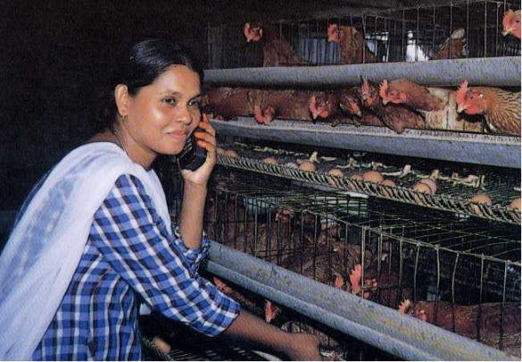
Networking and the Digital Divide
The Digital Divide
  Low penetration of Internet services
  Higher price
  Lack of adequate infrastructure
Success of cellular deployments
  No data services
  High subscription price
Rural mesh networks
  Local communication patterns
Goals:
  Low cost data communications
  Leverage cellular deployments
  Cater to local communications

Slide 3
Multihop Cellular Networks (MCNs)
Cellular network augmented by client-to-client Wi-Fi communications [Lin00] (A)
Rural (sparse) MCNs
  Large cell area
  Large per-client spectrum usage
Local traffic patterns (B):
  Cannot use cell tower
  Cannot form end-to-end paths
Need: efficient opportunistic client-to-client forwarding in sparse MCNs

Slide 4
Delay Tolerant Networks (DTNs)
Epidemic Routing [Vahdat00]
  Bundled data forwarded during every contact for eventual delivery
  Flood scoping by hop-count or TTL
PRoPHET [Lindgren04]
  Transitive destination contact probability as routing metric
  Data forwarded up a routing metric gradient
But, high cost of flooding creates network congestion
D
S
Cloud Routing (CR) [Wittie09]
  Network and traffic state disseminated over a control channel
  Forwards a small set of data copies
  Lower forwarding cost and higher network throughput
But, replication wastes network resources

Slide 5
Intra-flow Network Coding (NC)
Forwards randomly encoded data on each path
With high probability, data arriving on multiple paths is innovative
Codes are embedded in packets themselves [Chou03]
D
S

Slide 6
NC in DTNs
Network Coding Probabilistic Routing (NCPR) [Widmer05]
  Each node forwards floor(d) coded pieces and additional coded piece with probability d-floor(d)
  Stops forwarding after ceil(d) coded pieces
  New innovative coded pieces reset forwarding cap
D
S
But, tradeoff between high delivery rates and high load
Need a more efficient mechanism for reliability

Slide 7
Semi-Innovative Set Routing (SISR)
D
S
b – f
b
f
r
Linearly independent?

Slide 8
Semi-Innovative Sets (SISs)
D
S
b – f
b
f
r
s₁
s₂
f
s₃
SIS1
SIS2
SIS3

Slide 9
Semi-Innovative Sets (SISs)
D
S
b – f
r
f
b
b
f
r-2f
f
r
SIS1
SIS2
SIS3
SIS4
SIS5
SIS6

Slide 10
SISR in an MCN
D
D
n₁
n₂
n₃
S
b
b
r
r
d
SIS1
SIS1
SIS2
SIS2
SIS3
SIS3
SIS4
SIS4
SIS5
SIS5
SIS6
SIS6

Slide 11
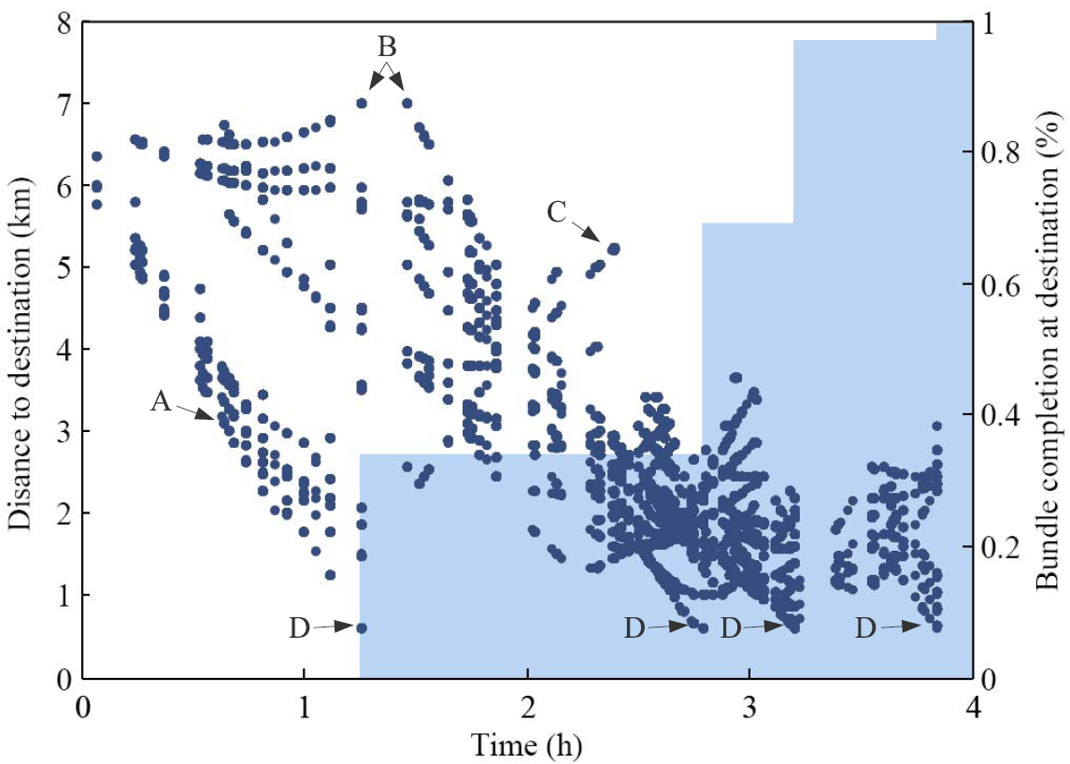
SISR Cloud Progress Example

Slide 12
Evaluation Setup
Want to compare SISR with CR and NCPR
  NCPR – flooding and network coding
  CR – small set of bundle copies
  SISR – network coded bundle + redundancy
Configuration details:
  Area, node density and mobility models a rural community
  Single flow between a node pair at different distances
  Interested in evaluating:
    Bundle forwarding cost
    End-to-end delay
    Control channel load

Slide 13
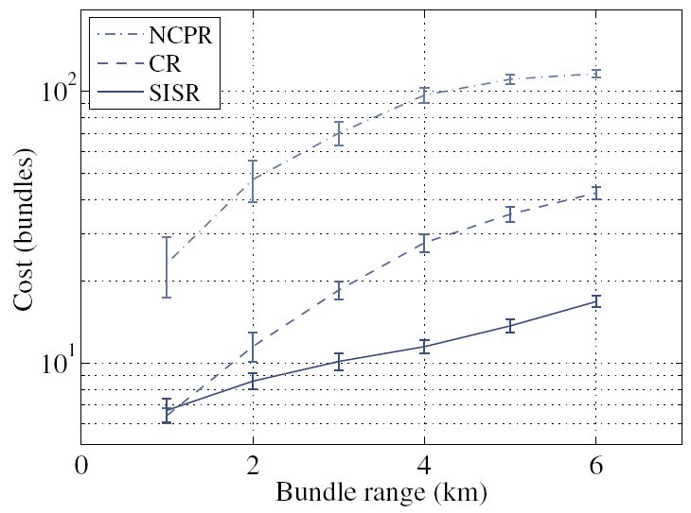
Forwarding Cost
Forwarding cost
  the amount of data forwarded in the network before delivery
NCPR – high cost of flooding
CR – high cost of replication
SISR – lowest cost
  Fraction of data on each path
  Improvements for multiple simultaneous flows

Slide 14
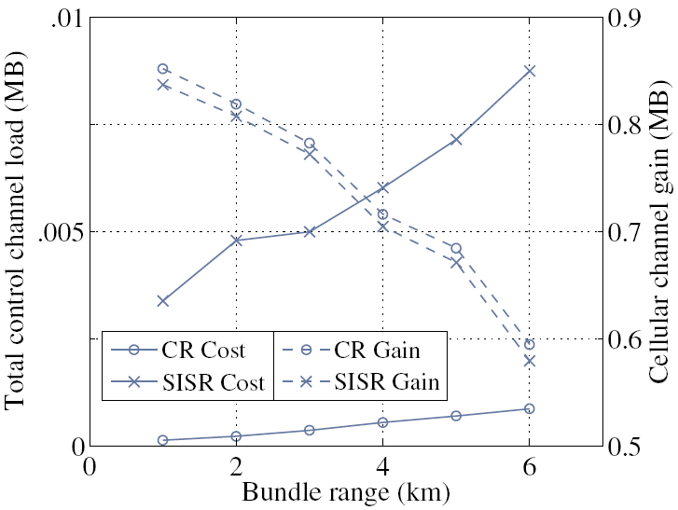
Overhead of Control Traffic
Control channel load
  Position updates
  Bundle progress notifications
  Data encoding vectors (SISR only)
Cellular channel gain
  Bundle size minus control traffic
Prevalence of position updates
Higher gain for multiple flows
Gain higher for CR, but SISR easier on client resources

Slide 15
Conclusions and Future Work
Introduced Semi-Innovative Set Routing (SISR)
End-to-end management of NC and forwarding mechanisms
  Only innovative data forwarded
  Tolerates any number of losses
2X reduction in forwarding cost
  Lower cost of infrastructure and data services
  Make data services affordable for more clients
Future work:
  Adaptation to different network settings
  Directional mesh networks with smart antennas
  Different ratios of data and control traffic propagation speeds
D
S
b
r
SIS1
SIS2
SIS3
SIS4
SIS5
SIS6

Slide 16
Thank You
Mike Wittie
mwittie@cs.ucsb.edu

Slide 17
Q & A

Slide 19
Backup Slides

Slide 20
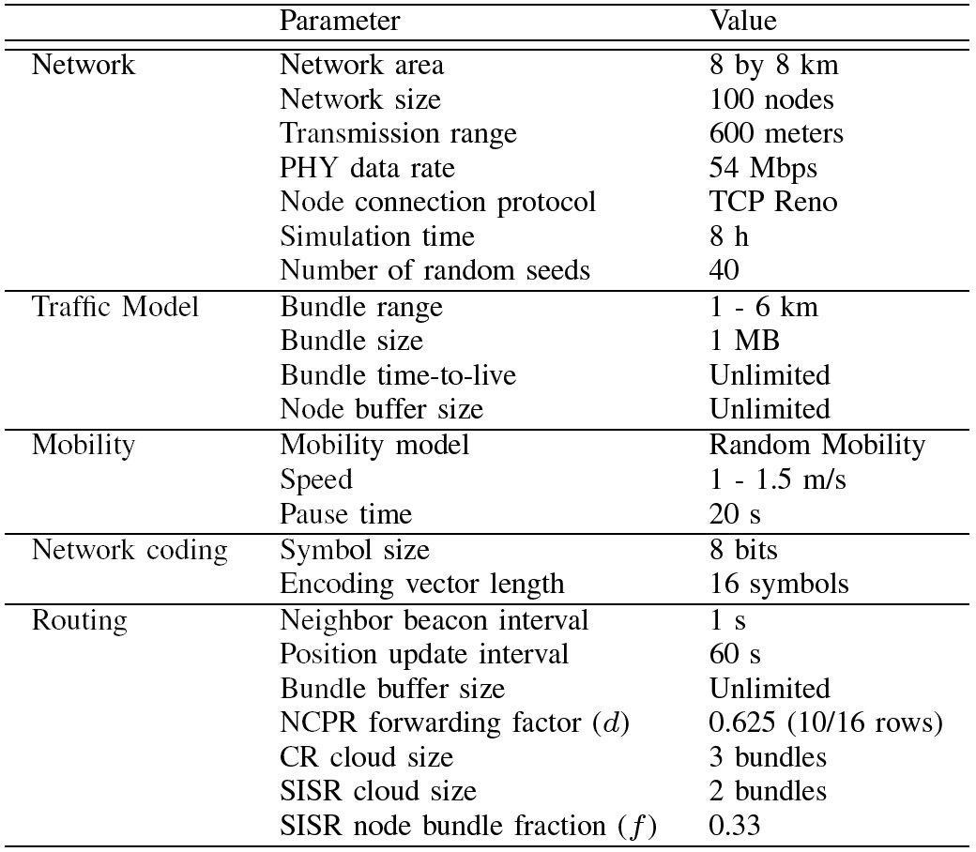
Evaluation Setup
Want to compare SISR with CR and NCPR
Configuration details:
  Area, node density and mobility models a rural community
  Single flow between random node pair
  NCPR – d configured for 100% delivery at 6km
  CR – lower forwarding cost at delay comparable to larger clouds
  SISR – lowest delay at 6km

Slide 21
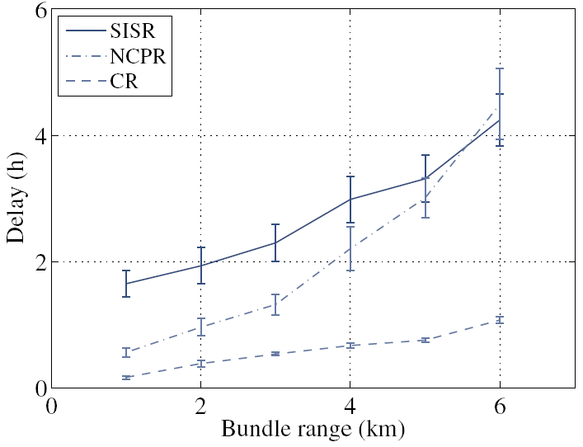
Bundle Delay
Delay
  end-to-end forwarding delay of entire bundle
  (all coded pieces)
SISR - last copy delay
NCPR – nodes use up forwarding allowance before delivery
CR – first copy delay

Slide 22
Multihop Cellular Networks (MCNs)
Cellular network augmented by client-to-client Wi-Fi communications [Lin00]
MCNs can:
  Reduce cellular channel load (A)
  Extend cell coverage (B, C)
MCNs make cellular infrastructure go further

Slide 23
MCNs in Developing Regions
Sparse MCNs
  Fewer clients and larger cell area
  Larger per-client spectrum usage
Local data communications
  Regional caches (B)
  Opportunistic client-to-client communications (C)
Our focus: opportunistic client-to-client forwarding in sparse MCNs

